Slide 1
Arduino Code
Mr. Kalmes

Slide 2
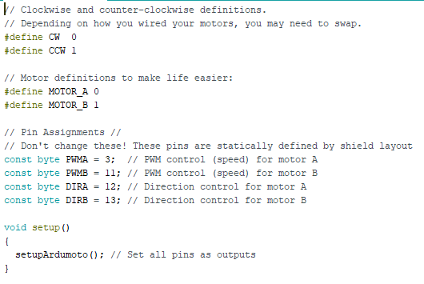
Part 1

Slide 3
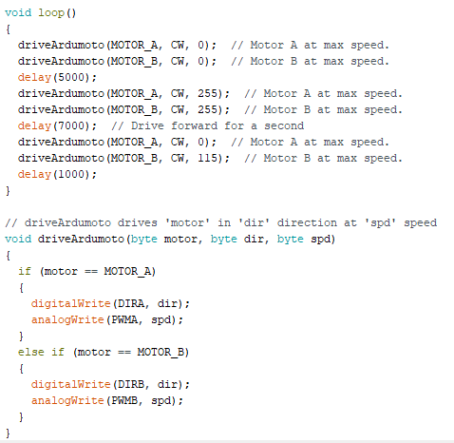
Part 2
This is where you add new code for the maze. Inside the void loop section

Slide 4
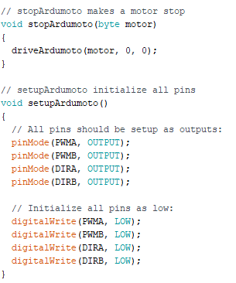
Part 3

