Slide 1
Escape the temple
BEGIN YOUR ADVENTURE

Slide 2
Background
You have been searching the abandoned catacombs for treasure all day.
As you wander down the dark tunnels, the floor opens up beneath you.
You fall into the dark abyss.
-----
You sit up. At first you are confused, but then you remember
what happened. You must escape.
Do You:
Explore Get Some Rest

Slide 3
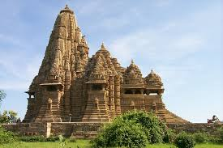
exploring
You stand up and walk down the only passageway,
and there’s a dark hole in the ground.
Do You:
Walk Around It Jump Down It

Slide 4
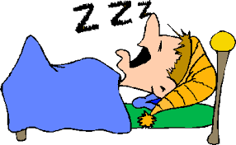
Getting rest
When you wake up, you feel refreshed and alert.
Then you see two buttons on the wall
that you didn’t notice before.
There’s also a passageway.
Do You?
Investigate The Passageway Investigate The Buttons

Slide 5
Walk around the hole
As you walk around the hole you hear
a clicking noise. All of a sudden something
sharp hits you in the back.
YOU DIE
Retry

Slide 6
Jump down the hole
You leap down in the darkness,
and land on top of wooden stakes.
YOU DIE
Retry

Slide 7
Investigate the buttons
You walk over to the two buttons.
On the wall above them it says:
INSERT THE CORRECT COMBINATION
Do You:
Push The Left Button Push The Right Button
Push Both Buttons Do Absolutely Nothing

Slide 8
You push the left button
The wall to the side of you grinds open,
and you walk down the hidden passage.
You walk into a room, and the entrance behind
you slams shut. There are two passageways.
Do You:
Go Left Go Right

Slide 9
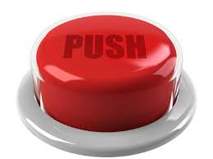
You push the right button
You get blown up.
YOU DIE
Retry

Slide 10
You push both buttons
You get blown up.
YOU DIE
Retry

Slide 11
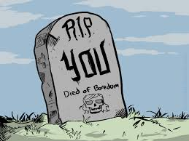
You do absolutely nothing
You die of boredom.
YOU DIE
Retry

Slide 12
You go left
There’s a dark hole in the
ground. You hear a hissing,
clicking noise.
Do You:
Jump Over It Jump Down It

Slide 13
You go right
There’s a button on
the wall.
Do You:
Push It Don’t Push It

Slide 14
Push The button
You get blown up.
YOU DIE
Retry

Slide 15
Don’t Push the button
You get bored and
push it anyways.
You get blown up.
YOU DIE
Retry

Slide 16
You jump over it
Spears shoot out of the
wall in front of you,
stabbing you.
YOU DIE
Retry

Slide 17
You jump down it
You jump down into the hole, and
get washed away by a
current of water.
You land in a passageway.
Do You:
Go Left Go Right

Slide 18
You go left
You go left, and accidentally release
a large boulder. It rolls down
the passageway towards you.
Do You:
Run Stand Against The Wall

Slide 19
you go right
I’m running out of death ideas.
YOU DIE
Retry

Slide 20
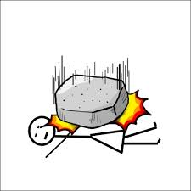
you run
You aren’t fast enough,
and you get squished
into a pulp.
YOU DIE
Retry

Slide 21
you stand against the wall
Luckily, the boulder rolls
past you. There is a ladder
leading up, and the passage also
turns right.
Do You:
Investigate The Ladder Go Down The Passageway

Slide 22
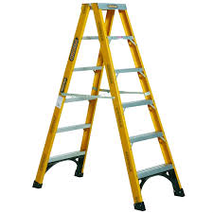
You investigate the ladder
You walk over to the ladder.
Do You:
Go Up It Go Down It

Slide 23
go down the passageway
You go down the passage,
and the ground opens up
beneath you, and you fall
to your death.
YOU DIE
Retry

Slide 24
you go up the ladder
The ladder breaks, and
you fall on your neck.
YOU DIE
Retry

Slide 25
you go down the ladder
You see a light.
Do You:
Go Towards It Take A Nap

Slide 26
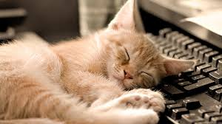
You took a nap
YOU FOOL YOU WERE
AT THE END AND YOU
TOOK A NAP
Retry

Slide 27
you went towards the light
Congratulations! You Escaped!
Victory Slide

Slide 28
YOU WON

