Slide 1
Java
Final CYAG
Mr. Kalmes

Slide 2
Requirements
You must create a cyag that has atleast 30 rooms.
Must be repeatable.
Must be school appropriate

Slide 3
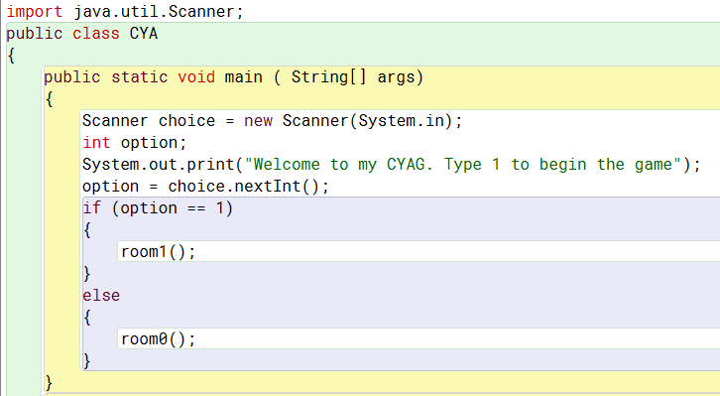
Example Code

Slide 4
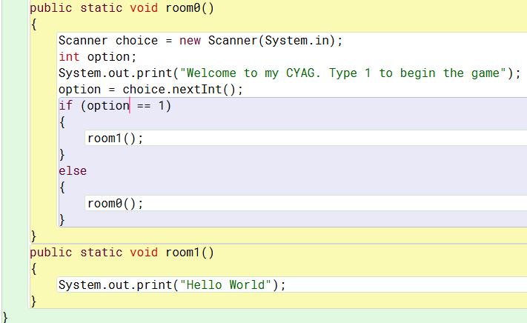
Example Code

