Slide 1
Java Lessons 13 – 16
Mr. Kalmes

Slide 2
Learning Targets
I will be able to compare strings
I will be able to create compound boolean expressions
I will be able to construct if-then statements

Slide 3
Lesson 13

Slide 4
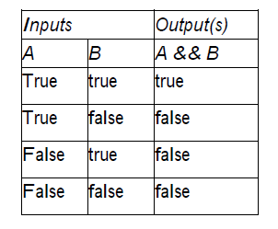
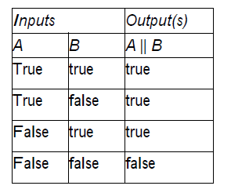
Lesson 14
And (&&) Table
Or (||) Table
This is how we create programs that uses more logic than just < or = to

Slide 5
Lesson 14

Slide 6
Lesson 15
If Then Statements:

Slide 7
Lesson 15

Slide 8
Lesson 15

Slide 9
Lesson 16

Slide 10
Lesson 16

Slide 11
Exit Slip
What symbol designates not in Java
What are the two outputs of a boolean expression

