Slide 1
Java Lessons 17 – 20
Mr. Kalmes

Slide 2
Learning Targets
I will be able to use else statements
I will be able to add strings to if-then statements
I will be able to explain mutual exclusion

Slide 3
Lesson 17

Slide 4
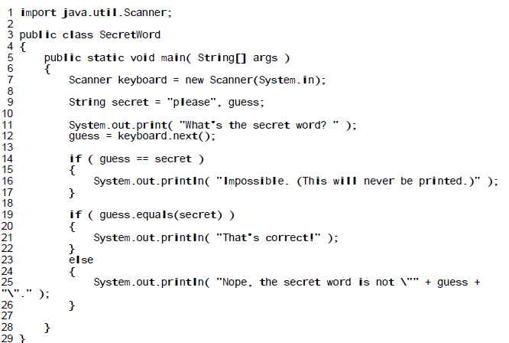
Lesson 18
guess == secret vs guess.equals(secret)

Slide 5
Lesson 19
Mutually Exclusive Events: if in the sample space there are no outcomes that satisfy events A and B at the same time we say that they are mutually exclusive. In other words, either event A happens, or event B, but not bot

Slide 6
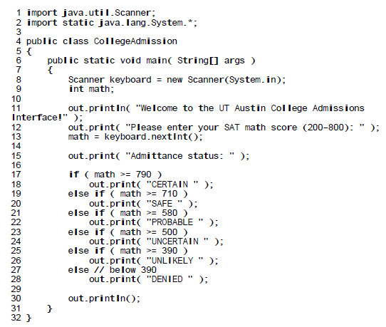
Lesson 20
Notes:
import static java.lang.System.*;
Basically allows you to type out.print or out.println instead of system.out.print
No { } on else if?

Slide 7
Exit Slip
Turn in your projects for the week

