Slide 1
Java Lessons 21 – 24
Mr. Kalmes

Slide 2
Learning Targets
I will be able explain what nesting is
I will be able explain what a switch is
I will be able to compare strings

Slide 3
Lesson 21

Slide 4
Lesson 21

Slide 5
Lesson 22

Slide 6
Lesson 22

Slide 7
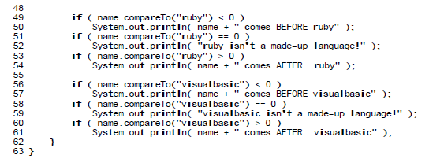
Lesson 23

Slide 8
Lesson 23

Slide 9
Exit Slip
What is nesting?
Explain how a switch works

