Slide 1
Java
Lesson 27
Mr. Kalmes

Slide 2
Hi-Low Game
Today you will be tasked with creating a hi-low game. You do not have to have a counter and it does not have to be repeatable. All I am giving you is the beginning of the program. The rest is up to you.

Slide 3
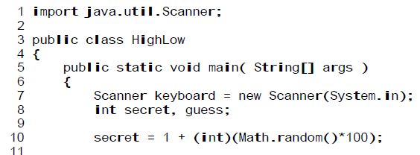
Start of program

Slide 4
Exit Slip
Turn in your projects for the week

