Slide 1
Java Lessons 33 – 34
Mr. Kalmes

Slide 2
Learning Targets
I will be able explain he difference between a math and a computer function
I will be able to write and call a function

Slide 3
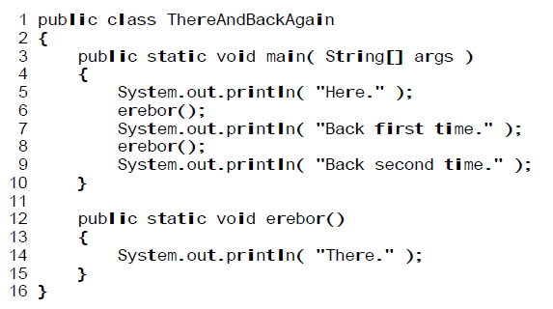
Lesson 33
Modify the program to include a second function

Slide 4
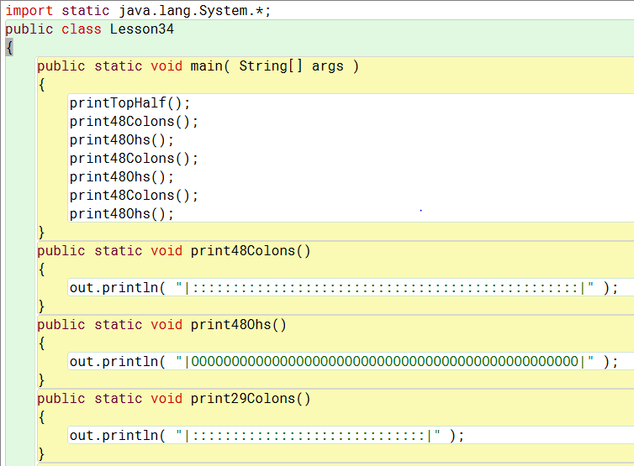
Lesson 34

Slide 5
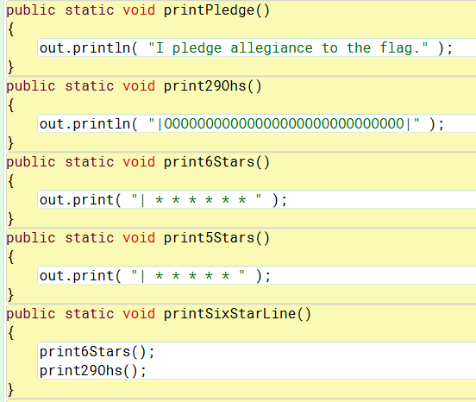
Lesson 34

Slide 6
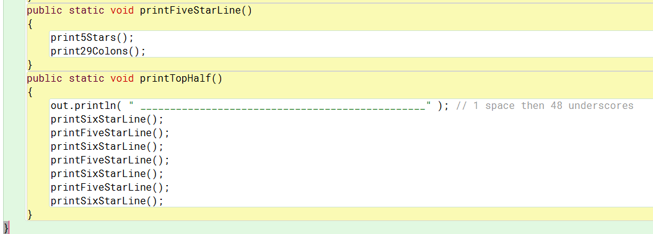
Lesson 34

Slide 7
Exit Slip
Explain how a function works?

