Slide 1
Java Lesson 35
Mr. Kalmes

Slide 2
Learning Target
I will be able to use functions in my code
I will be able to create a game called Yacht

Slide 3
Lesson 35
Today you will be creating a game called Yacht. It is the original version of Yahtzee. The idea of the game is to roll the dice until all dice equal the same number. This program will continue to roll until a Yacht is reached. It will also show what dice were rolled.

Slide 4
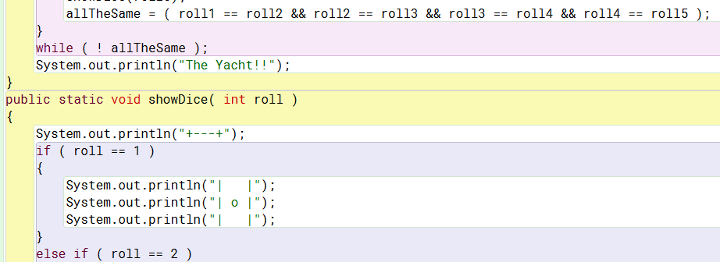
Yacht Code

Slide 5
Your program
Your Yacht program must include a sixth dice. I have given you enough code to complete this program.

Slide 6
Exit Slip
Were you able to finish you game today?

