Slide 1
Java Lesson 36
Mr. Kalmes

Slide 2
Learning Targets
I will be able to explain why parameters are important to functions
I will be able to create a program that uses functions

Slide 3
Lesson 36
some functions have parameters and some do not. Parameters are the only way to send values into a function. There is also only one way to get a value out of a function: the return value.

Slide 4
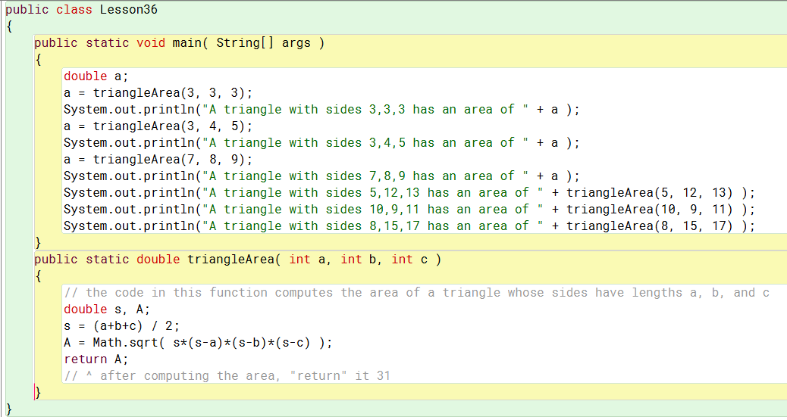
Lesson 36
+++ Add to the program +++
*** find the area of a triangle with sides 9, 9, and 9 ***

Slide 5
Lesson 36
Important Takeaways:
The function does not use Public Static Void
Void is used when the function does not return a value
There are other types
Void – Does not return a value
Int – Returns a integer value
Double – Returns a double value
String – Returns a string value

Slide 6
Exit Slip
Why are parameters important for functions
List 2 different types of return values of a function

