Slide 1
Java Lesson 37
Mr. Kalmes

Slide 2
Learning Targets
I will be able to create a program that uses functions

Slide 3
Lesson 37
You and a partner must create a program that calculates the area of a triangle, circle, and rectangle. Each should return a value based on the function you create. Each person must turn in their own project.

Slide 4
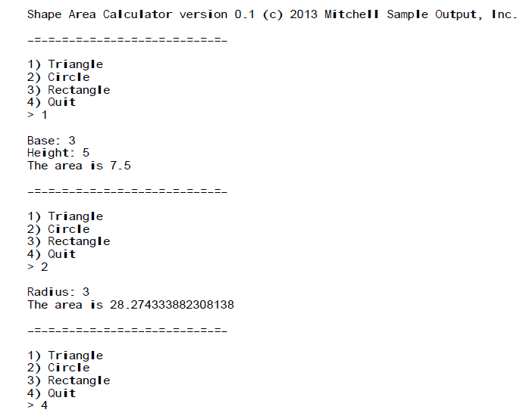
Lesson 37
What you should see

Slide 5
Exit Slip
What was the hardest part of creating this program?

