Slide 1
Java Lessons 38 - 41
Mr. Kalmes

Slide 2
Learning Targets
I will be able to explain why functions are important
I will be able to create a text file
I will be able to import variable from a text file

Slide 3
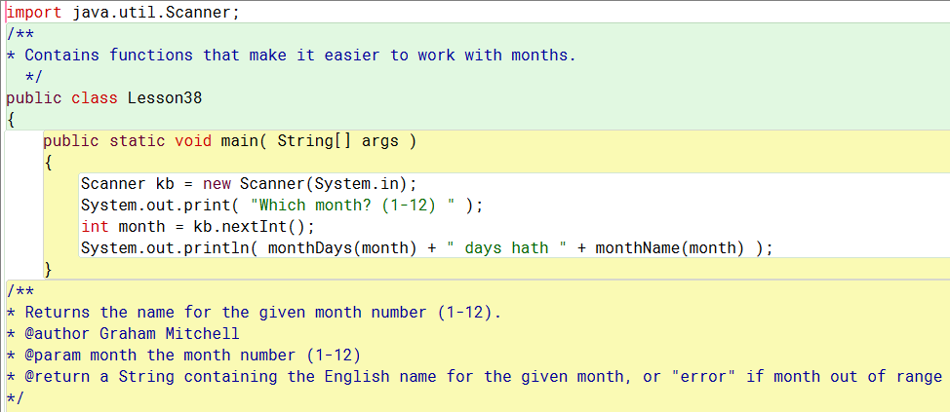
Lesson 38
Part 1

Slide 4
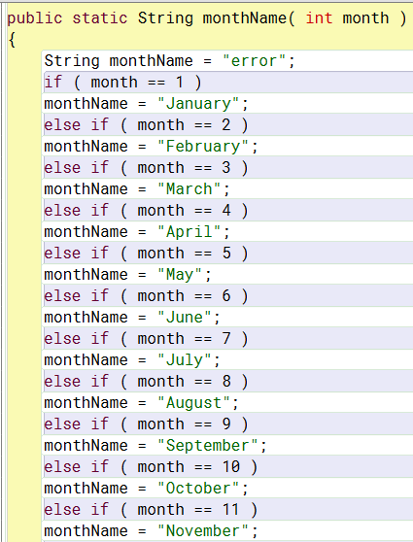
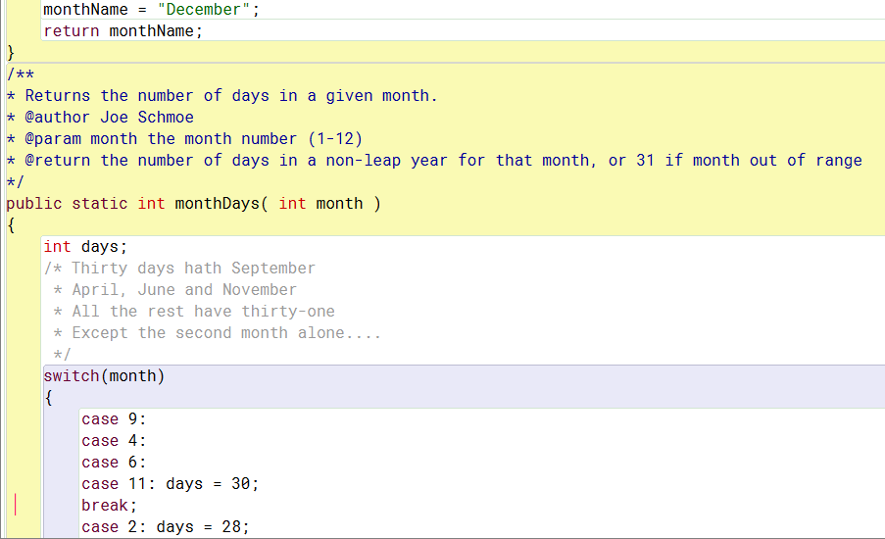
Lesson 38
Part 2
Part 3

Slide 5
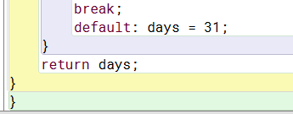
Lesson 38
Part 4

Slide 6
Lesson 38
Important Notes

Slide 7
Lesson 39

Slide 8
Lesson 40
Lesson Overview: Students are going to create a program that can put information into a text file instead of only being able to print things on the screen.

Slide 9
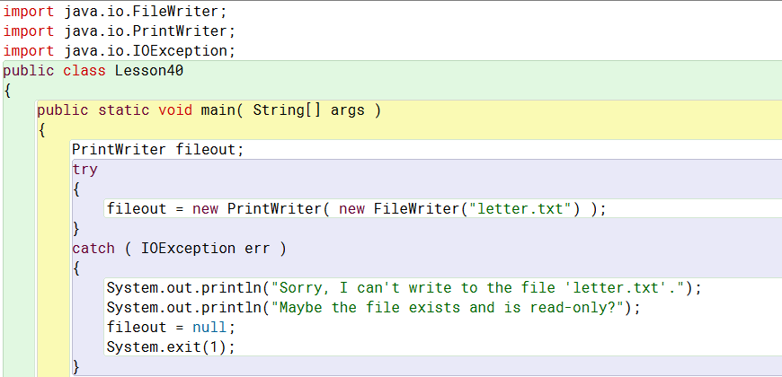
Lesson 40
Part 1

Slide 10
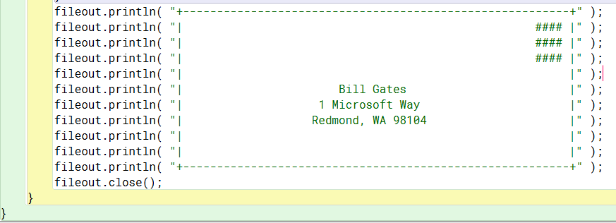
Lesson 40
Part 2

Slide 11
Lesson 40
Once you run this program it will seem as though nothing happened. This is not true. Go to the folder where you saved this project and locate the file called letter.txt. Open it up and see what it is.

Slide 12
Lesson 41
In order for this program to work, we need to do a little setup. You need to open up a program called note pad. You need to type your name on the first line, and three numbers on line 3, 4 , and 5. You then need to save the file as Lesson41.txt into the java folder that contains this project.

Slide 13
Lesson 41

Slide 14
Lesson 41
An example of what you should see the following
If your program did not work please go back through and check to make sure your code is correct

Slide 15
Exit Slip
Please complete your exit slip via the website

