Slide 1
Java
Lessons 38 - 41
Mr. Kalmes

Slide 2
Learning Targets
I will be able to create a coin flipping game

Slide 3
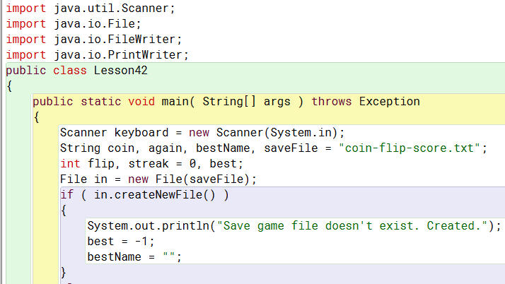
Lesson 42

Slide 4
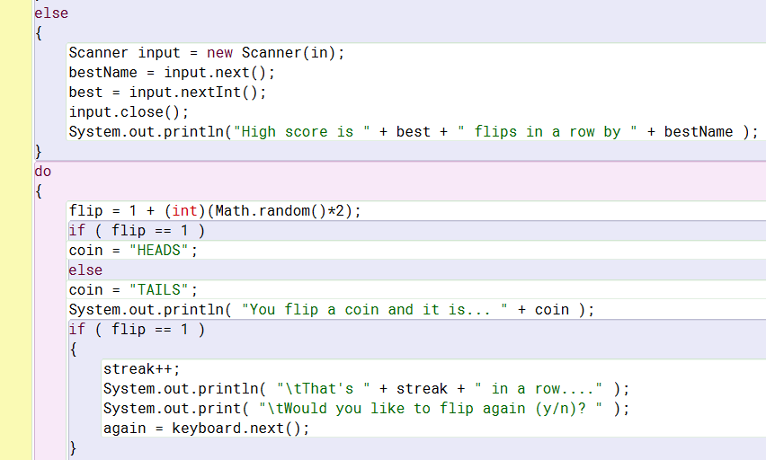
Lesson 42

Slide 5
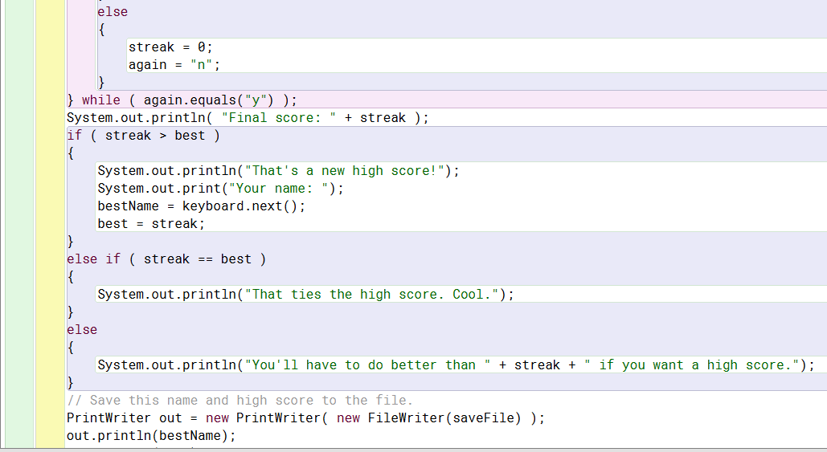
Lesson 42

Slide 6
Lesson 42
Today you will be working on creating a coin flipping game. You will need to add on two parts to the game. The first is to show the coin with either heads or tails. The second is to add in a function to make the game repeatable.

Slide 7
Exit Slip
Please complete your exit slip via the website

