Slide 1
Java
LESSON 50
Mr. Kalmes

Slide 2
Learning Targets
I will be able to create a deck of cards

Slide 3
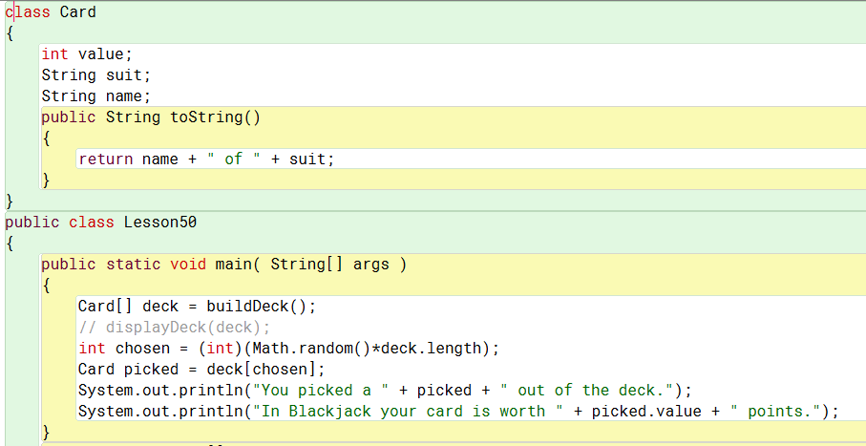
Lesson 50

Slide 4
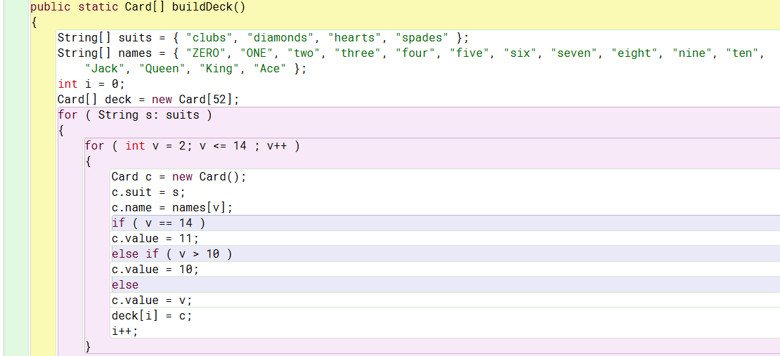
Lesson 50

Slide 5
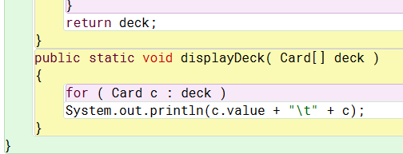
Lesson 50

Slide 6
Exit Slip
Turn in your programs

