Slide 1
Java Lessons 5 – 8
Mr. Kalmes

Slide 2
Learning Targets
I will be able to utilize variables
I will be able to develop interactive programs
I will be able to create input variables
I will be able to explain the concept of the computer human interface

Slide 3
Lesson 5
Variable names can be more than one letter long.
Variables can hold more than just numbers; they can hold words.
You have to choose what type of values the variable will hold when the variable is first created.
The value of a variable (but not its type) can change throughout the program.

Slide 4
Lesson 5
Types of variables:
Integers
can hold a value between ± 2 billion
Doubles
can hold a number that may have a fractional part.
Holds value between ± 1.79769 × 10³⁰⁸ and 4.94065 × 10⁻³²⁴
Strings
can hold words or phrases

Slide 5
Lesson 5

Slide 6
Lesson 6
Mathematical Symbols:
Plus Sign (+) will add different variables together
Minus Sign (-) will subtract integers or doubles
Asterisk (*) will multiply integers or doubles
Slash (/) will divide integers or doubles
Percent (%) The remainder after division

Slide 7
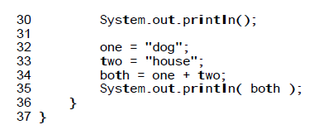
Lesson 6

Slide 8
Lesson 7

Slide 9
Lesson 7

Slide 10
Lesson 8

Slide 11
Exit Slip
List 2 of the 4 rules of variables
What are the 3 type of variables

