Slide 1
Java Lessons 9 – 12
Mr. Kalmes

Slide 2
Learning Targets
I will be able to utilize variables
I will be able to fix logical errors
I will be able to construct variable shortcuts
I will be able to explain boolean expressions

Slide 3
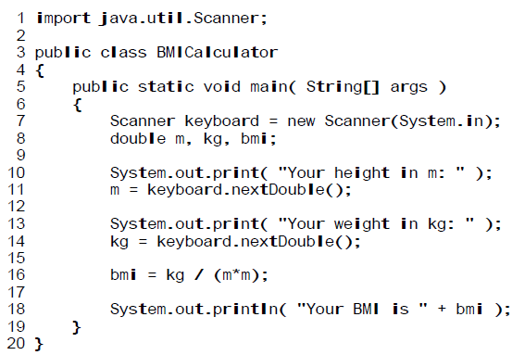
Lesson 9
Create the following program
Change the program to convert lbs to kgs and inches to meters

Slide 4
Lesson 10
Logical Error:
a flaw with the flow of instructions, so that the output is not what was trying to be accomplished.

Slide 5
Lesson 10

Slide 6
Lesson 11
Shortcuts:
x += n or x -= n or x *= n or x /= n or x %= n
x++ or x--
Be careful: x =+ and x=- are different

Slide 7
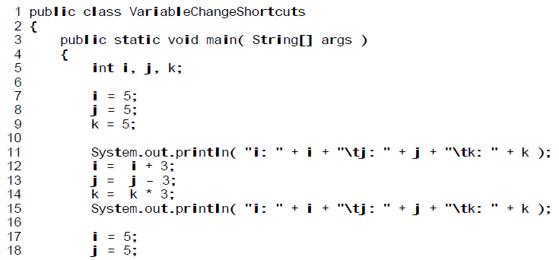
Lesson 11

Slide 8
Lesson 12
Boolean Variables:
Can not hold numbers or words
Can only hold two values – True or False
They are used to perform logical calculations

Slide 9
Lesson 12

Slide 10
Exit Slip
What is a logical error
What’s the difference between += and =+
How do you think you will use boolean expressions?

