Slide 1
Java Lessons 1 & 2
Mr. Kalmes

Slide 2
BlueJ
The program we will be using for JAVA is called BlueJ. Please click on the icon on your desktop to open it

Slide 3
How to use BlueJ

Slide 4
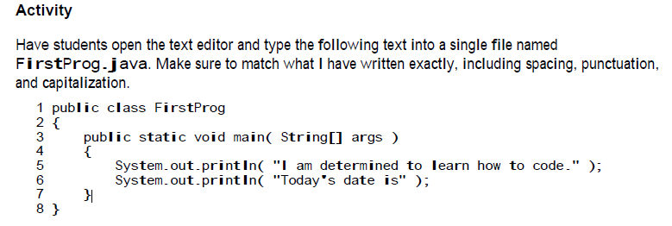
Lesson 1
After copying the code please add 4 lines to it.
Let Mr. K know when you are done so I can check it.

Slide 5
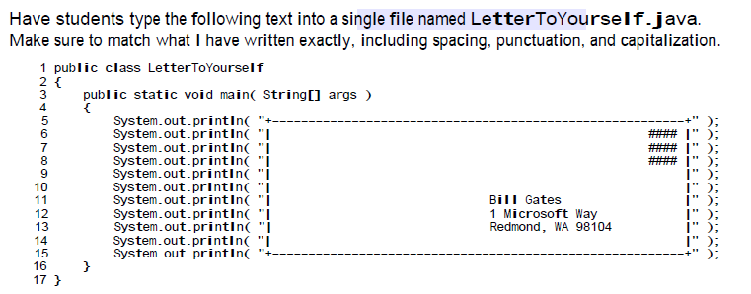
Lesson 2
Create the following envelope
Change the stamp
Change the Address

Slide 6
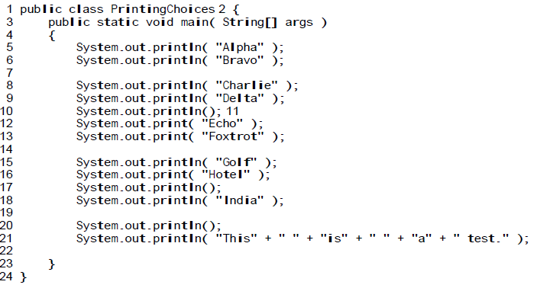
Lesson 3
Change the wording to something you would like

Slide 7
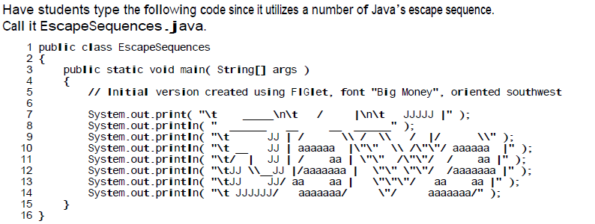
Lesson 4

