Slide 1
Java Lessons 28 – 32
Mr. Kalmes

Slide 2
Learning Targets
I will be able explain what an infinite loop is
I will be able to implement error checking into my code
I will be able to create an accumulator in my code
I will be able to create the dice game Pig

Slide 3
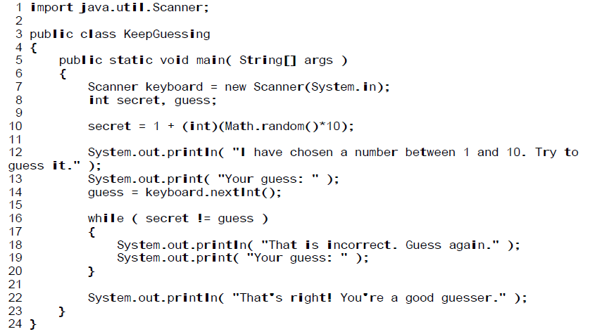
Lesson 28
Type the following program:
Fix the program so it does not have an infinite loop and turn in the completed project

Slide 4
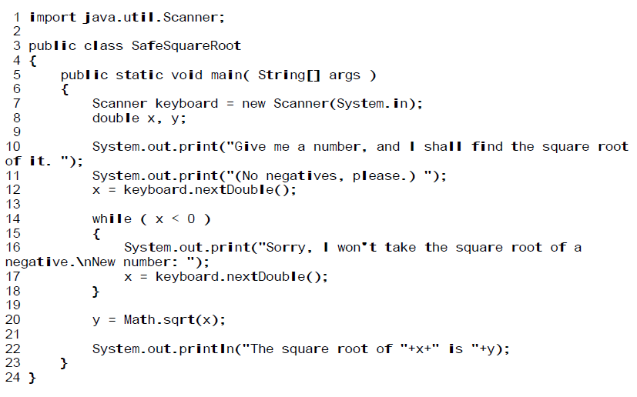
Lesson 29
Type the following program:
***
***

Slide 5
Lesson 29

Slide 6
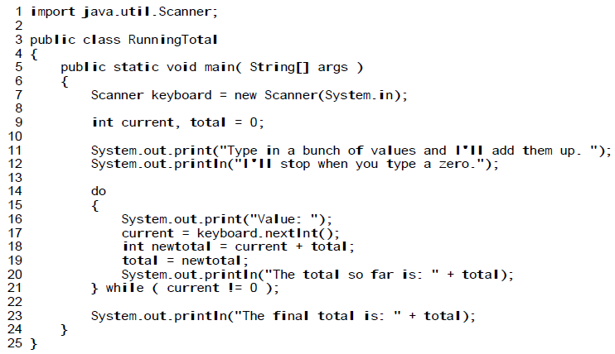
Lesson 30
Type the following program:
***
***

Slide 7
Lesson 31 & 32
On the next two slide I will give you the AI code and the pseudo code for the entire project. It is up to you to put it together correctly.

Slide 8
PIG AI CODE

Slide 9
Pig Pseudo Code Part 1

Slide 10
Pig Pseudo Code Part 2

Slide 11
Exit Slip
Tuesday:
How does an accumulator work?
Thursday:
Turn in your projects for the week

