Slide 1
Java Lessons 43 - 47
Mr. Kalmes

Slide 2
Learning Targets
I will be able to explain looping
I will be able to explain arrays
I will be able to create programs using looping and arrays

Slide 3
Lesson 43

Slide 4
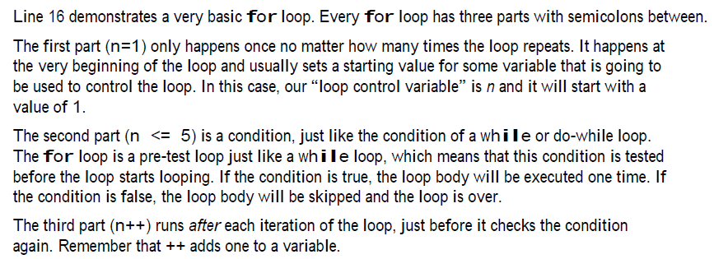
Lesson 43

Slide 5
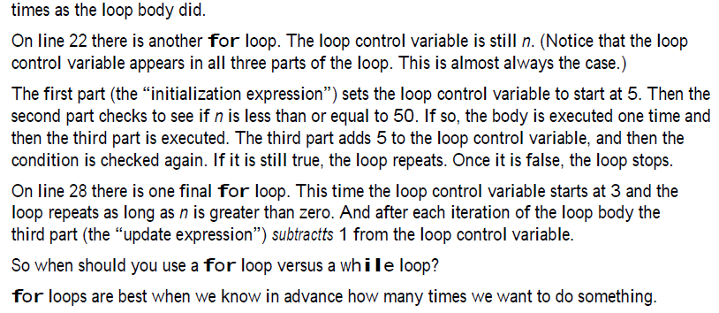
Lesson 43

Slide 6
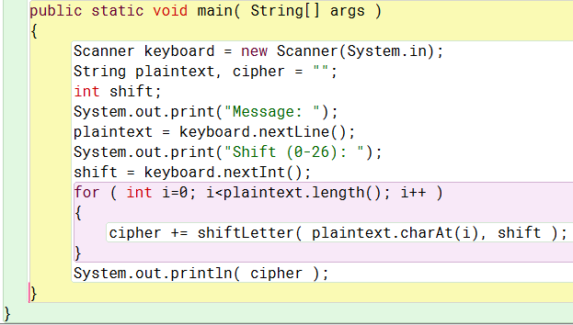
Lesson 44

Slide 7
Lesson 44

Slide 8
Lesson 44

Slide 9
Lesson 45

Slide 10
Lesson 45

Slide 11
Lesson 46

Slide 12
Lesson 46

Slide 13
Lesson 46

Slide 14
Lesson 47

Slide 15
Lesson 47

Slide 16
Lesson 47

Slide 17
Lesson 47

Slide 18
Lesson 47

Slide 19
Exit Slip
Turn in your programs

