Slide 1
Java Lessons 48 & 49
Mr. Kalmes

Slide 2
Learning Targets
I will be able to explain arrays
I will be able to create programs using arrays

Slide 3
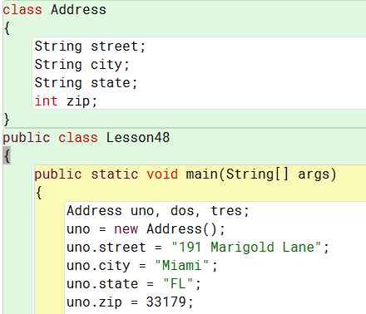
Lesson 48

Slide 4
Lesson 48
Please add 2 more entries. You will not get full credit for the assignment unless there are 5 entries

Slide 5
Lesson 48

Slide 6
Lesson 49

Slide 7
Lesson 49
Please add 2 more entries. You will not get full credit for the assignment unless there are 5 entries

Slide 8
Lesson 49

Slide 9
Lesson 49

Slide 10
Lesson 49

Slide 11
Exit Slip
Turn in your programs

