Slide 1
Just Basic Lessons 11 - 12
Mr. Kalmes

Slide 2
Lesson 11 Learning Targets
Construct a program that records 10 names
Understand the value of arrays in coding

Slide 3
Lesson 11 Activity
You will create a program that can ask, store, and print out a list of 10 names

Slide 4
What is an Array?
Arrays are collections of indexed variables, which are defined as either string or numeric. They are most often used to store a list of related items, with any item's value being retrievable by refering to its index number

Slide 5
Start of Program

Slide 6
End of List

Slide 7
End of program

Slide 8
program example

Slide 9
Lesson 12 Learning Targets
Develop programs that utilize arrays

Slide 10
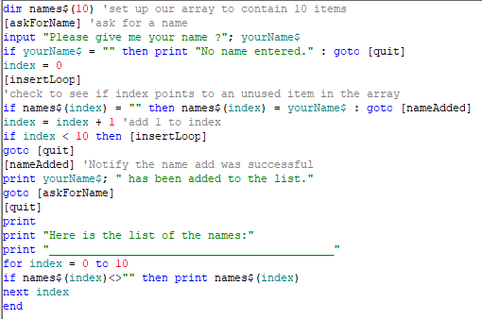
Lesson 12 Activity
Open up BASIC and create the following program. You need to add the final part of the program that prints out the index.

Slide 11
What’s New
DIM: This function sets the dimensions for your array
INDEX: This acts like count but is used to catalog names
: This symbol allows the user to insert grey text which can be used for instructional purposes
'

Slide 12
Lesson assignment
This assignment is an extension on the previous program. You need to build a numerical array that will hold numbers instead of names. This program should hold up to 50 numbers at a time. It does need to print the numbers at the end of the program.
Reopen your program from the previous lessons and use that as your template on how to start this new build. It does not need to be exactly the same, it just needs to work.

