Slide 1
JUST BASIC
Lesson 10
Mr. Kalmes

Slide 2
Learning Targets
I will be able to create a hi-low guessing game

Slide 3
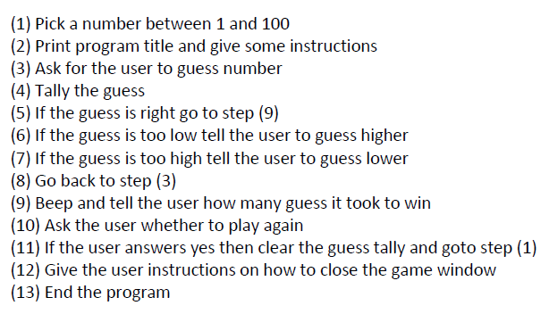
Pseudo Code

Slide 4
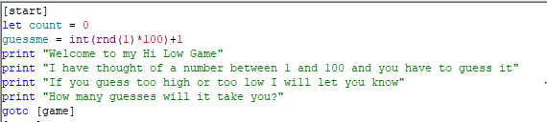
Start of Program

Slide 5
Finish the program
Your challenge for today is to finish the hi-low game. I have given you the pseudo code and the start of the program. This is an individual assignment. Once you are finished please test it to make sure it works and does not repeat the previous number. It must also be repeatable.

Slide 6
Exit Slip
Turn in your Hi – Low Game

