Slide 1
Just Basic Lesson 15
Mr. Kalmes

Slide 2
Lesson 15 Objectives
Understand the concept of GUI
Program windows for display of varying sizes, shapes, and colors

Slide 3
Lesson 15 Journal
In your journal list what other programs you can run on a computer besides text based ones.
The windows used to run these programs are called graphical user interface windows, or GUI.

Slide 4
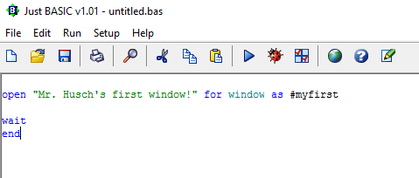
Lesson 15 Activity
Build the following program

Slide 5
Result of program

Slide 6
Alterations
We can also change the size by changing the variables WindowWidth and WindowHeight.
We can change where it will open on the screen by changing UpperLeftX and Upper LeftY.
We can insert buttons in the window with the button command.

Slide 7
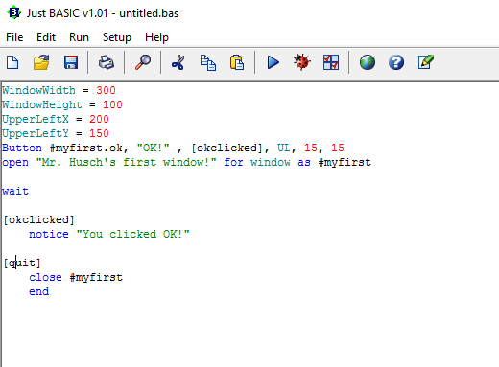
Lesson 15 Assignment
Use the following code as your baseline
create your own unique window
It must be your own

Slide 8
Exit Slip
Please complete your exit slip via google forms

