Slide 1
Just Basic Lessons 15 - 16
Mr. Kalmes

Slide 2
Learning Targets
I will be able to explain what a graphical user interface
I will be able to create windows in Just Basic

Slide 3
Lesson 15 & 16
Graphical User Interface (GUI):
it is a part of the computer that allows for creation of windows and other images on the computer

Slide 4
Lesson 15 & 16
Window Commands:
WindowWidth = changes the size of the window width
WindowHeight = changes the size of the window height
UpperLeftX = changes where on the screen the window will open
UpperLeftY = changes where on the screen the window will open

Slide 5
Lesson 15 & 16
Window Commands:
statictext #handle.name, x-pos, y-pos, length, height
textbox #handle.name, x-pos, y-pos, length, height
button #handle.name, “button text”, [section], UL, x-pos, y-pos, length, height
wait & notice
print #handle.name, "!contents? string$"

Slide 6
Lesson 15 & 16
Window Commands:
trap close: properly closes a window

Slide 7
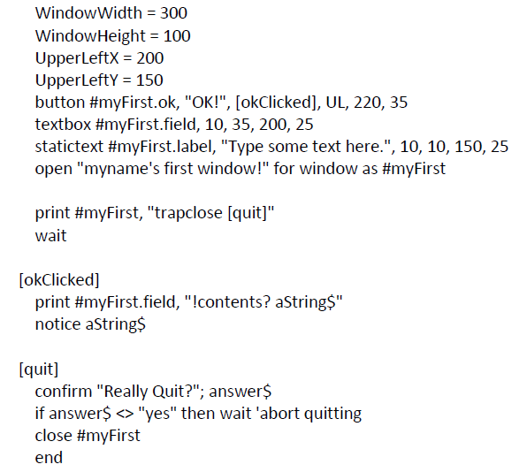
Lesson 15 & 16
This is an example of a program

Slide 8
Lesson 15 & 16
Challenge Activity:
You need to create an window with static text, text boxes, and 3 buttons. The static text must be instructions on how to use the window. One button must open a notice with what was written in the first text box. The second button must open a second window with some static text. The third button will be a close button that closes the window and ends the program. Not a trapclose!

Slide 9
Exit Slip
Turn in the following programs:
Challenge Activity
Answer the following question(s):
What type of programs can you make with the GUI

