Slide 1
Just Basic lesson 16
Mr. Kalmes

Slide 2
Objective
Create a program that creates advanced windows in Just Basic
Understand how to troubleshoot errors before they happen

Slide 3
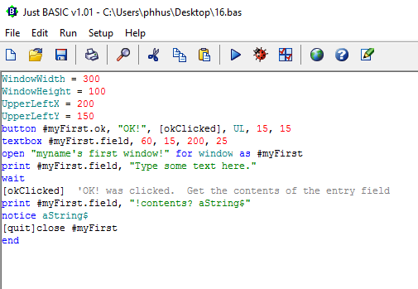
First build

Slide 4
Differences
Line starting with textbox
The textbox command create the text with the handle #myFirst.field whereas the numbers denote its position in the window.
It also displays the text we entered by the “!contents? aString$” sequence in the print line.
Make sure that the command starts with an exclamation point (!) or it will not work.

Slide 5
Add to the program
You can add instructions for the users with a static text box. Add that with

Slide 6
Add to the program
Play with the inputs and dimensions to alter the position of the windows, textbox, and instructions.
Now you need to add a trapclose, this will create a button for you to close the button. The program for the trapclose is on the next slide. You will need to make minor adjustments to make it work perfectly for you.

Slide 7
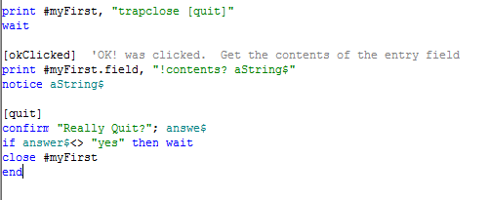
Trapclose

Slide 8
Save
Save this program as LastName_Lesson 16

