Slide 1
Just Basic Lesson 17 Part 1
Mr. Kalmes

Slide 2
Lesson 16 Solution

Slide 3
Learning Targets
I will be able create a windows based game in just basic

Slide 4
LESSON 17 PART 1
Today you will be creating a high low windows game. I have provided the code for you but I also want you to modify it to make it your own. There are several ways to achieve this. Simply copying the code will not be good enough

Slide 5
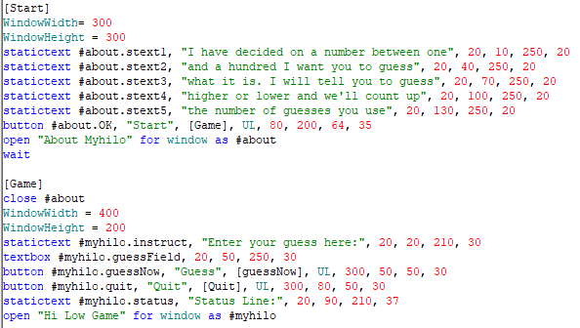
Lesson 17 part 1
Code Part 1

Slide 6
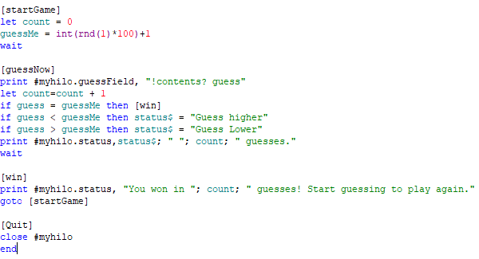
Lesson 17 part 1
Code Part 2

Slide 7
Exit Slip
Answer the following question:
What did you modify in your program?
What is the code to close a window in JB?

