Slide 1
Just Basic Lesson 18
Mr. Kalmes

Slide 2
Objective
Understand how to draw using BASIC commands
Construct their own drawings in BASIC

Slide 3
Concept
You can create drawings with JustBasic.
The idea is to send commands to the computer that tell it to use a virtual pencil that will go up and down off of the screen and move around much like when they put a pencil to paper. The following is a short list of commands that can be given to the computer.

Slide 4
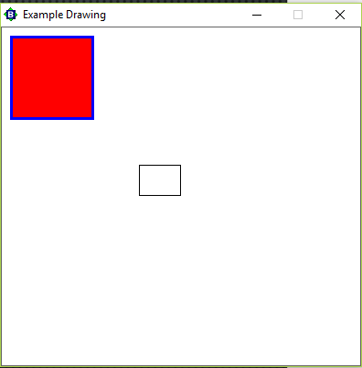
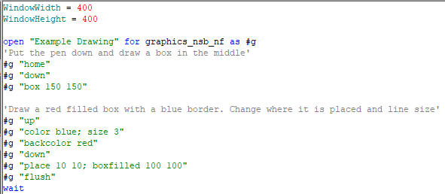
Example

Slide 5
Handout 1
open “name” for graphics_nsb_nf as #g
up - lift the pen up (don't draw)
down - lower the pen down (draw)
home - place the pen in the center of the graphics area
goto -go to a specified position
place - go to a specified position but don't draw

Slide 6
Handout 2
5 Graphic Commands
Box: "box 150 150"
Circle: "circle 63"
Ellipse: "ellipse 100 50"
Line: "line 10 50 10 250"
Filled Shapes
Must have - "backcolor 127 127 127 or backcolor color“
Box: "boxfilled 150 150“
Circle: "circlefilled 63"
Ellipse: "ellipsefilled 100 50"

Slide 7
Assignment
Part 1: Draw the following shapes
Circle
Triangle (hint: Use lines think coordinate graph)
Bullseye (5 circles with middle one filled)
Clock with hour and minute hand
Snowman with eyes and mouth

Slide 8
Assignment
Part 2: Draw the following
You need to draw a beach scene that includes:
Sand
Water
Sky
Sun
Clouds
Kite

Slide 9
Exit Slip
What was the most difficult shape for you to create and why?

