Slide 1
Just Basic Lesson 19
Mr. Kalmes

Slide 2
Learning Targets
I will be able create a windows based game in just basic

Slide 3
LESSON 19
Today you will be creating a windows based mad lib game. On the next couple of slides are the requirements and a sample program for you use to start your program.

Slide 4
Mad Lib Requirements
Must have a start screen with 2 buttons one for each mad lib.
Each button must open a new window
Each mad lib must have at least 10 inputs
After your inputs are made there needs to be a button that leads to the story
There needs to be 2 buttons on the story page. One that leads to a new start menu and one that leads to the end of the program

Slide 5
Sample program
Sample Code Part 1

Slide 6
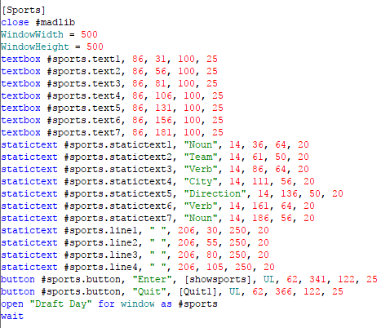
Sample program
Sample Code Part 2

Slide 7
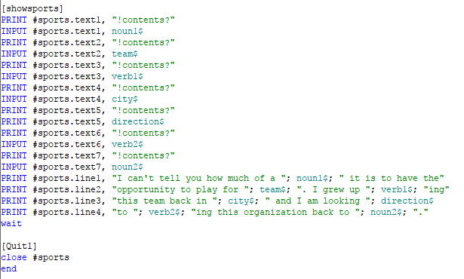
Sample program
Sample Code Part 3

Slide 8
Your Mad Lib
Now it is your turn. Have fun creating this program. We will be sharing these and doing a peer review.

Slide 9
Exit Slip
Answer the following question:
What are the 2 subjects of your mad libs

