Slide 1
Just Basic Lesson 20
Mr. Kalmes

Slide 2
Learning Targets
I will be able create a windows based game in just basic

Slide 3
LESSON 20
Today you will be creating a windows based CYA game. On the next couple of slides are the requirements and a sample program for you use to start your program.

Slide 4
LESSON 20
CYA Game: Choose Your Own Adventure is a game where the story is written from a second-person point of view, with the reader assuming the role of the protagonist and making choices that determine the main character's actions and the plot's outcome

Slide 5
Cya Requirements
Must have a title screen
Must have 25 – 30 rooms
Must have a way to win
Must be repeatable w/o restarting program

Slide 6
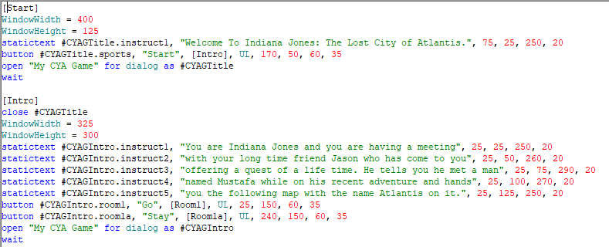
Sample program
Sample Code Part 1

Slide 7
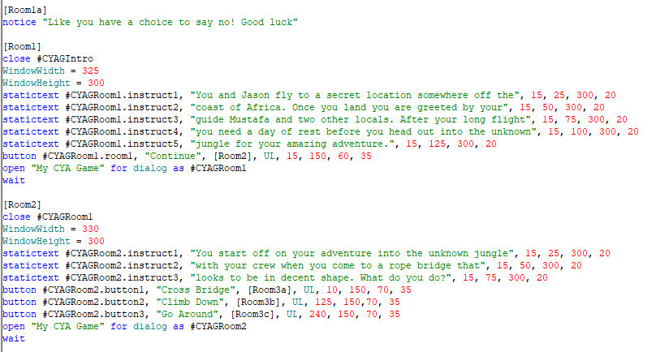
Sample program
Sample Code Part 2

Slide 8
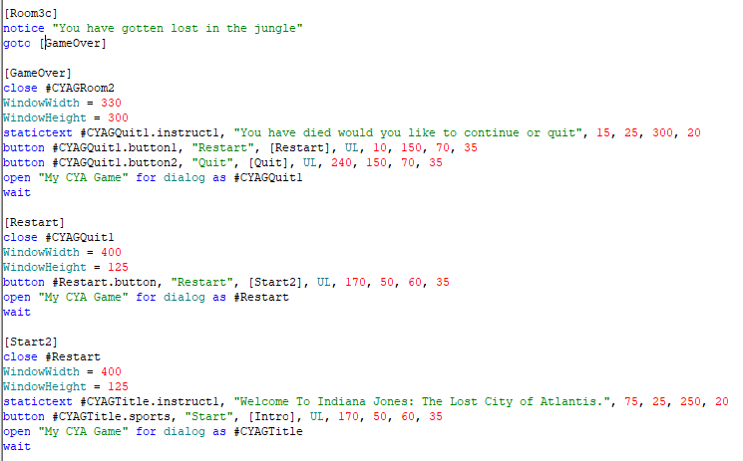
Sample program
Sample Code Part 3

