Slide 1
Basic Lessons 5 & 6
Mr. Kalmes

Slide 2
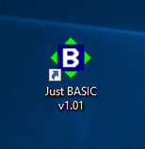
Step 1
Open up the basic program.

Slide 3
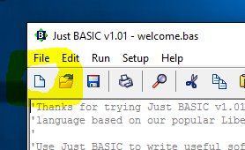
Step 2

Slide 4
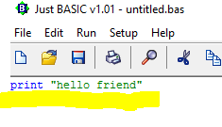
Step 3
Type in the following.
Print “hello friend” then click the run button.

Slide 5
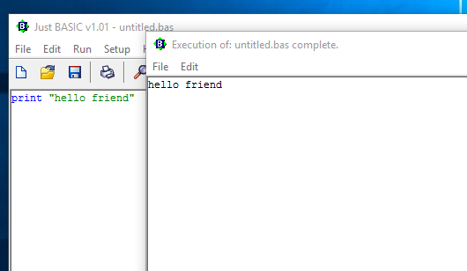
Step 4
Click the run button
What does print mean in this program?

Slide 6
Step 5
Congratulations you have your first program in Basic!
Please click on the journal and answer the prompts

Slide 7
Definitions
Input: Fathering of information needed for calculations.
Calculation: Manipulation of information.
Output: Display of final calculation and overall solution to the code.

Slide 8
Discussion
Do any of you work as a cashier?
Inputs vs Outputs

Slide 9
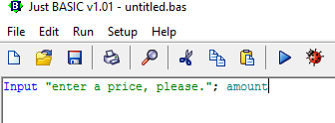
Input
In basic type:
Input “enter a price, please.”; amount

Slide 10
Discussion
When you hit run what pops up?
Why doesn’t “amount” pop up?

Slide 11
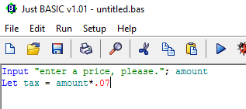
Calculation
Now we need to add to our program.
Let tax = amount*.07
In this program the word LET allows us to create a variable.

Slide 12
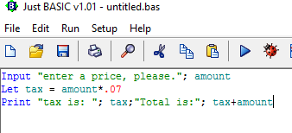
Output
Now we need to include our output.

Slide 13
Create Program #1
You will need to create your own program now with tax = .05 and you should have the program ask for the user to “type a dollar and cent amount?”
When done CHECK THE PROGRAM if it works save as, and title the program “Lastname_Cashier” (ie Kalmes_Cashier”)

Slide 14
Create Program #2
You will now need to make a basic calculator with one function
You can choose to add, subtract, multiply, or divide
When done CHECK THE PROGRAM if it works save as, and title the program “Lastname_Calculator” (ie Kalmes_Calculator”)

Slide 15
Exit Slip
Your exit slip for today if for you to tell me how you feel about this program and how it compares to previous programs that we have used.

