Slide 1
Just Basic Lessons 9
Mr. Kalmes

Slide 2
Lesson 9 Objectives
Define and use functions in BASIC
How to comment on code in BASIC

Slide 3
Previous Learned
Input Data
Display with print
Store data using strings
Using If-Then statements to control programs

Slide 4
What’s new

Slide 5
LEN ( )
The LEN ( ) function is a command that gives the number of characters in a string
You can also loop functions

Slide 6
Looping

Slide 7
What happened
What did the program do and why?

Slide 8
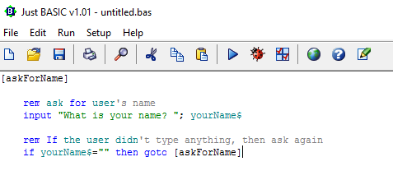
Commenting
In order to make comments in BASIC use the REM tag on a separate line

Slide 9
Lesson assignment
Your assignment is to write a program that will loop numbers 1-100 and count how many total numbers that is. You need to include rem into this as a reminder of what you built.

Slide 10
Journal & Exit Slip
Please complete your journal & exit slip

Slide 11
Basic games
Please download and play the games on BASIC to get an idea of what is possible to create

