Slide 1
Life of a secret Gamer
Begin Game

Slide 2
Introduction
Once before there was a boy named Jessie. He was an athlete and had many friends because of his interest in sports. He loved sports and no one could take that away from him but he loved something else much more. He loved console gaming but none of his friends knew, and none of them also enjoyed it ,they were pc gamers. One day he is playing Black Ops 3 and his friend calls him wanting to play basketball. Its double experience weekend, what do you do?
Blow Him Off
Meet up with him and play basketball
Pretend you’re sick and stay home to play-

Slide 3
You’re so Lonely
Your friend becomes offended because you blew him off and know there is no longer a friendship between you two. After he then begins bullying you ,which leads to school transfer. You should’ve just played with him.
GAME OVER- Start Over

Slide 4
Modz For Life
You leave to go with your friend right after a Modder try's to give you all the knew guns. This upsets him and he has a little pay back. He boots you offline for a matter of months. Now your gamer experience has been cut short nerd.
GAME OVER –Start Over

Slide 5
Wreck Some Noobs
You’ve just lied to your best friend and the guilt is getting to you but you have a 7 kill streak. You’re in a lobby with all squeakers and it’s just too easy but your friend is alone and bored. You can apologize to him and join in a game of bb or you can stay home and kill some scrubs. What do you do?
Apologize and play with your friend
Stay home and keep up with the act

Slide 6
Worst Day Ever
You join your best friend and you two play. At first it seems as if you’ve done the right thing but later it’s the total opposite. You become bored with the activity and day dream about Call of Duty all day regretting your decision. You then die of boredom( not realistically) .
Game Over –Start Over

Slide 7
The Guilt Consumes You
You stay home and keep the secret you’ve been hiding from your friend when eventually the guilt consumes you. At this point you dint care if you’re going to miss the game or not. You only care about your friend.
Go to the park

Slide 8
F.U.N
Surprisingly your friend does some really interesting stuff that you’ve never seen him do before. You guys then begin telling each other secrets ,will you reveal your deepest secret?
Reveal your secret
Tell him a Lie

Slide 9
Speaking the Truth/Its not Lag
You tell your friend the truth and he blankly stares at you, then you see movement….. He’s smiling and laughing, he’s known all along. Your mom gave you up when he called in the past.
Continue

Slide 10
Really Again with all the Lies
This is the second time you’ve been dishonest to your best friend and he suspects something. You can feel him coming on to you and figuring out the truth.
Continue

Slide 11
NOO COME BACK
Your friend soon figures out you're lying and demands the truth ,you refuse to tell him. Say goodbye to your friendship with him because he's tired of all the lies you're feeding him.
Spill The BEANS already
Forget your friendship with him

Slide 12
Dude I know A Modder
Your friend confesses he also is a console gamer, along with PC. He says he diversifies. You feel relieved and satisfied with your friendship, and you also feel trolled considering you’ve been hiding this forever. He tells you about this insane console Modder that he's friends with, you cant wait to go GOD MODE with your best friend.
Continue

Slide 13
Should’ve been honest
You’ve just lost one of your best friends to a game dispute, how bad could it have really been. Maybe he would’ve accepted you, you never know. Now you're depressed and you want to play some Call Of Duty to get over the whole day.
Continue

Slide 14
Hopefully I Don’t Rage
You begin playing cod and there are multiple snipers camping and its so irritating ,so you join a new lobby. In this new lobby you notice a clan that is exactly like your clan on PC. Do you ask them or keep to yourself ?
Ask the Clan about themselves?
Keep to yourself

Slide 15
Hello My Name is Jeff
You address the clan and they all sound too familiar to you. You then quickly recognize their gamer tags as your friends from PC. You're confused and you ask what they're doing on console ,they respond with “ Looking for an old friend.” You then realize that they all obtain a console game.
Result in Apologizing Immediately
Blame everything on them

Slide 16
Don’t I know You
You keep quiet and nothing happens…. Until they speak to you. They say they know you and know you recognize them. Then you immediately realize they are your friends and they all obtain a console game.
Apologize Immediately
Blame everything on them

Slide 17
We accept but….
You tell all of your PC friends you’re sorry that lied all this time and you did some really messed up stuff. They accept your apology but request something in exchange for their friendship…… They want you to 1v1 them all while they have mod menu activated. Do you accept the challenge?
I accept
I decline

Slide 18
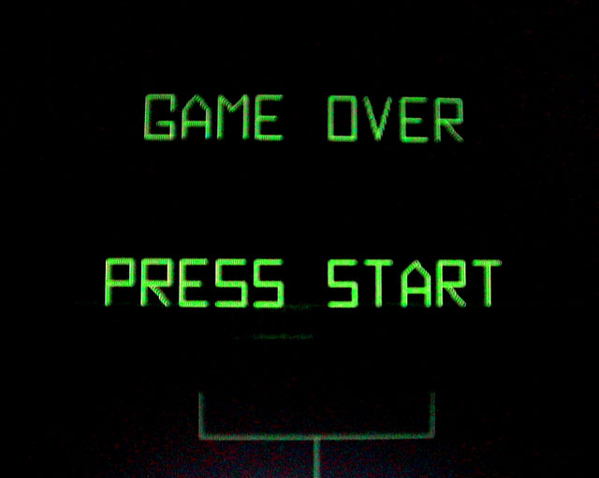
Its your fault
You tell your friends they’re the reason you lied. You say they weren't good friends and never understood you. Basically you say “ It’s your fault!” That statement was the end of your friendship. You know are a lonely little squeaker without anyone to back you up from the master prestige.
Game Over-Start Over

Slide 19
I accept your Challenge
You accept the challenge your friends bring upon you and this is a step in the right direction. You lose ultimately at like 30-3 but you have your friends back and on a new type of game. This is the beginning of a new time of friendship and hardcore gaming on the ps4. Btw. Play Station for life.
Continue

Slide 20
I DONT accept your challenge
You don’t accept the challenge your friends offered and that was a big mistake. You're friends feel as if you don’t appreciate them trying to work things out. They block you on ps4 and PC ,now you have no friends and they don’t forget they had modded accounts. They have a backup Modder on their side and he boots you offline for a month.
Game Over- Start Over

Slide 21
You Win ! ! !
You have your friends on your side and you now know they all have consoles so you guys can play together. Great Job your hidden life is coming to the open. It’s out of the corner and it stopped camping. Now it’s time to murder some noobs on B.O.3.

