Slide 1
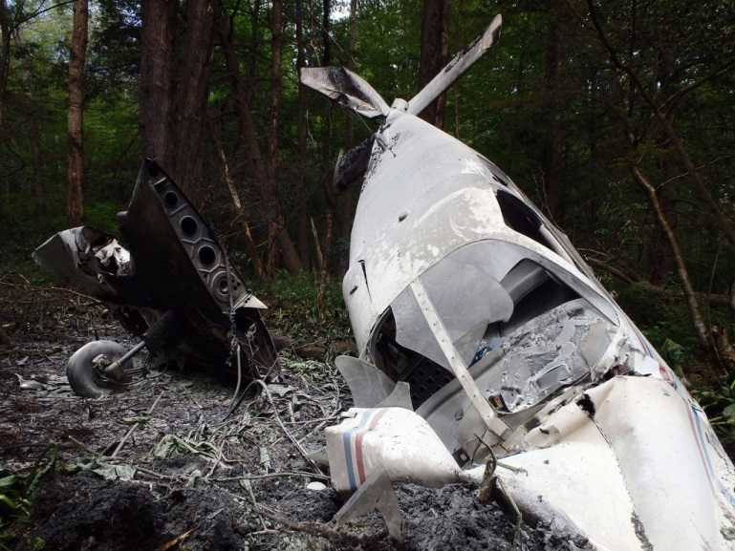
Lost In The Woods
A Choose Your Own Adventure Story
BEGIN

Slide 2
Chapter 1
You wake up lying on sand, the ocean splashing at your feet. You’re stomach feels like it’s being stabbed by a thousand nails. Fully opening your eyes for the first time you notice a plane wing to your left. What happened?
a. Try to get up
b. Call for help
c. Scream in pain

Slide 3
Chapter 2
You have success getting up and assess the damage to your stomach, and find that you’re bleeding out. You need to find medical equipment, and quick. You turn around to find a plane; that has obviously been through some damage. Were you on that plane?
a. Ignore the plane in search for supplies in the nearby woods
b. Search the plane
c. Search the unopened suitcases by the plane

Slide 4
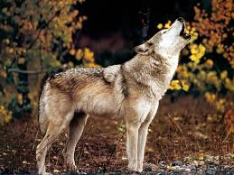
R.I.P
A wild animal hears your call and since you are unable to get up, it eats you whole.
START OVER

Slide 5
Chapter 3
You open all 13 of the suitcases you find. You acquire a machete, two first aid kits, a bottle of water, a cellphone, and three granola bars. The cellphone has 3% battery and no service; useless. What will you do now?
a. Chop down some trees
b. Eat all of the granola bars to satisfy your hunger
c. Use the first aid kit

Slide 6
Rest In Peace
You get lost while searching for supplies in the woods and after a week of wandering around, you die.
START OVER

Slide 7
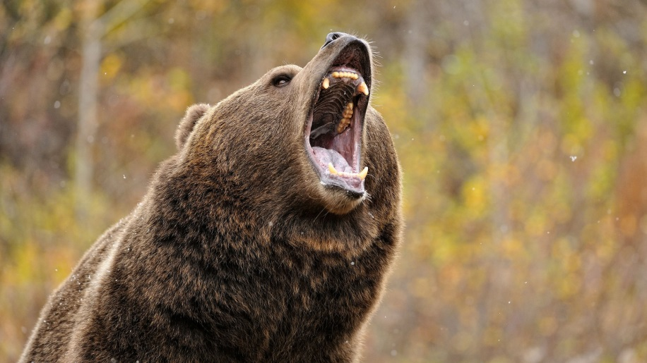
You’re Dead
When you enter the plane you are greeted with a surprise, a brown grizzly bear. The bear kills you.
START OVER

Slide 8
Chapter 4
Good job, you successfully healed your stomach wound! You hear a rushing stream just down the hill but also see a light source near the plane. Is the light a help signal? Will the water lead out of the woods to civilization? Which will you head towards?
a. Water source
b. Light source

Slide 9
Bye World
You seem to have forgotten about your stomach wound and while chopping down trees, you bleed out.
START OVER

Slide 10
Dead.
Even though you satisfy your current hunger you don’t have any food for later, but before you die of starvation you bleed out through your stomach wound.
START OVER

Slide 11
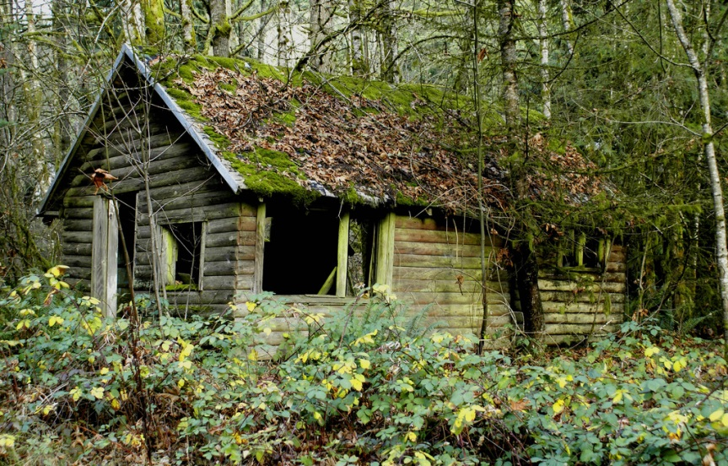
Chapter 5
When you reach the stream you encounter a house! It’s boarded up and has a “KEEP OUT” sign written in red paint. Is it red paint?
a. Enter the house
b. Ignore the house and keep moving
c. Go back to the plane

Slide 12
You are dead
While you walk forward you encounter a strange woman, who you try to converse with. She pulls out a dagger and murders you.
START OVER

Slide 13
Death
The light source turns out to come from a pit. As you descend into the pit you realize the light is nothing more than a reflection of sun. When you decide to head back up, you see there’s no way to climb back up.
START OVER

Slide 14
Chapter 6
You enter the house to find a huge barrel of supplies. Jackpot! Then you hear a twig snap. “Hello? Is anyone there?” you call. Suddenly the door bursts open and a young woman appears holding a dagger, and charging straight at you.
Grab your machete and attack
Raise up your hands in defense
Run

Slide 15
R.I.P
You couldn’t get to your machete in time and the woman stabbed you in the heart.
START OVER

Slide 16
Death
You can’t get away in time and she successfully kills you.
START OVER

Slide 17
Chapter 7
You brace yourself for the blow of the dagger, but it doesn’t come. You open your eyes to see the woman standing in front of you, the dagger inches away from your heart. She glances at you, doesn’t say a word and walks off. Who is this mysterious woman and why does she look so familiar?
FOLLOW HER

Slide 18
Chapter 8
You run outside and see footprints in the snow. The woman’s tracks. Although you look to the left and see a bit of cloth on the branch, possibly the woman’s. Which way should you go?
Follow the footprints
Follow the cloth

Slide 19
R.I.P
The footprints end up stopping after a certain point, so you head to turn back. But when you turn around you realize you’re completely lost, as the footprints have disappeared.
START OVER

Slide 20
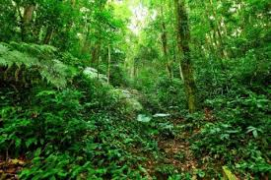
Chapter 9
The cloth leads to an opening between to trees. You hear voices and laughter. Could this be civilization?
Enter

Slide 21
Chapter 10
You enter the opening to find all kinds of people dancing, laughing, and talking. This is civilization! Yet when you enter all eyes turn on you. What do you do?
Explain who you are
Run back out

Slide 22
Chapter 11
“….I am not a threat, I just want to go home back to my family” you end the speech with. The people cheer and about 10 run up to you, welcoming you and offering to help you. You’re safe!
PLAY AGAIN

