Slide 1
Minion Adventure!
Click here to start your adventure

Slide 2
Starting the Journey!
Your goal is to save the minions. If you fail, you die, and that’s how life is. Don’t argue. You are in the minion world. By the way, there is only one way to win.
Go back home using Computer Tech!
Go and attempt to save the minions. Save

Slide 3
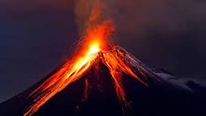
Go back home using Computer Tech
You couldn’t change your life. Since you decided to go home, you did the coding wrong, so now you are sent to a volcano. You are burnt in lava, and never found. Rest In Peace.
One step back
Back to Start

Slide 4
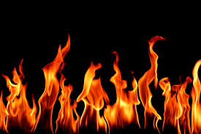
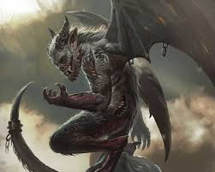
Go and Save the Minions
Gru orders to do 3 trials to save the minions.
Fight Gru
Wait Fire, water, Boss Battle!
Do the 3 trials

Slide 5
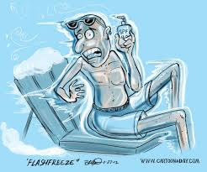
Fight Gru
You fall down the lab, and you get hit by the mighty Gru. You eventually fail, and he turned you into ice using his Freeze Ray. Rest in Peace.
One step back
Back to the start

Slide 6
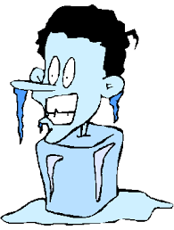
Wait
Gru rushes you, and kills you with the Freeze Ray. Good Job. RIP.
One step back
Go back to start

Slide 7
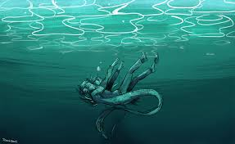
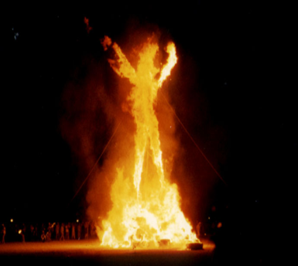
Do the 3 trials
Gru is happy, and gives you a choice. Fire or water. The boss battle branch would be the last branch you would have to do.
Water Branch
Fire Branch

Slide 8
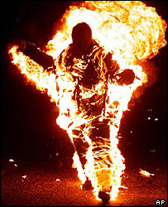
Fire Branch
Don’t assume that fire brings you to the fire branch. You got burned. Good night. RIP.
One step back
Back to start

Slide 9
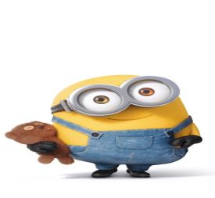
Water Branch
In this branch, you must swim, hold your breath, and save 10 minions in just 45 minutes, or else, you head would be chopped off by Gru.
You have 3 clans that you could save. Each clan has 10 minions. Choose wisely. Good luck.
Kevin Clan
Bob Clan
Stuart Clan Clan Clan Clan

Slide 10
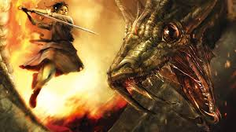
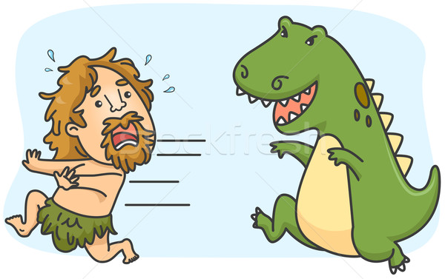
Kevin Clan
You see a dragon! What would you do?
Fight
Run

Slide 11
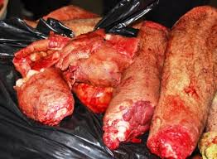
Run
You get caught, and get shredded by the dragon. RIP.
Step back
Back to Start This is you, shredded.

Slide 12
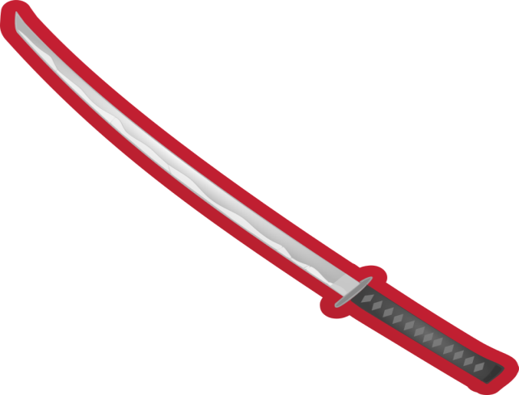
Fight
You fight, and you win a sword! You see the Kevin Clan minions! What do you do?
Wait
Show minions sword
Stop the mission THE MISSION!

Slide 13
Wait
You drown. RIP.
One step back
Back to Start

Slide 14
Stop the mission
You stop the mission. But before you could reach the surface, you drown to your death.
RIP.
One step back
Back to start

Slide 15
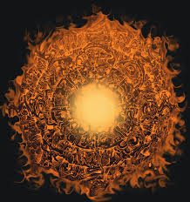
Show minions sword
The minions go up to the surface! The minions have been saved! You win for the branch! Now you could got to the real fire branch!
Real Fire Branch
Back to start
Restart Trial

Slide 16
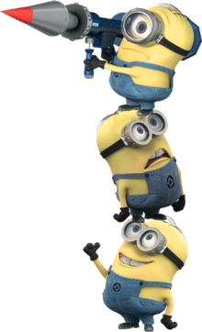
Bob Clan
You see the minions right off the bat! But at this zone, time is sped up. Choose wisely.
Save the 10 minions that is your goal. Good luck.
Save Minions Save
Wait

Slide 17
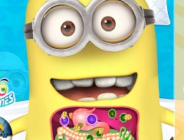
Save Minions
You try to save the minions but fail, because the minions already decided to eat you up. RIP!
Back one step
Back to start
You are eaten.

Slide 18
Wait
You wait and hold your breath, but then you see the minions go up to you! The minions have saved you! You are a survivor! You win! Now you could go to the real fire branch!
Real Fire Branch
Restart Water Branch
Back to start

Slide 19
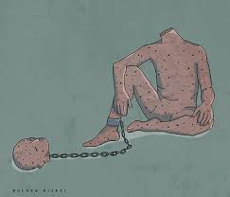
Stuart Clan!
Gru forces you to make a decision. But before you choose Stuart, Gru chops your head off. RIP.
One Step Back
Back to Start

Slide 20
Real Fire Branch!
You are pressured to make a decision. There are 3 neighborhoods that you could save. Each one has 10 houses. Remember you have a 30 minute time limit.
Kevin Neighborhood
Bob Neighborhood
Stuart Neighborhood Neighborhood Neighborhood Neighborhood

Slide 21
Kevin Neighborhood
You see the minions. But the houses are filled with fire. Fear made you wait. Gru chopped your head off because you are OUT OF TIME! RIP!
One step back
Back to Start

Slide 22
Stuart Neighborhood
Stuart isn’t that welcoming. He chopped your head off with the chainsaw. RIP. Hope you go to heaven.
Back one step
Back to start

Slide 23
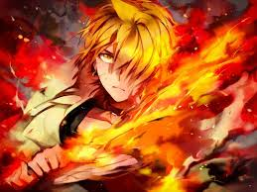
Bob Neighborhood
You accidently burn yourself, but then you realized the Bob kingdom gave you the power to be immune to fire! Yeah!
Save
Save Minions
Wait

Slide 24
Wait
You wait, and get hanged by Gru, because you’re OUT OF TIME! Your head is off! RIP!
Back One Step
Back to Start

Slide 25
Save Minions
You win, and get back to a safe place. You are back to the lab, and you see the boss battle portal is open! Will you survive fighting the demon?
Boss Battle Branch
Restart Fire Branch
Back to Start

Slide 26
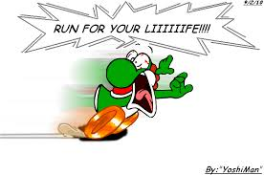
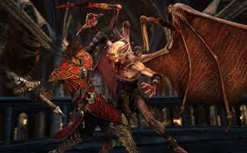
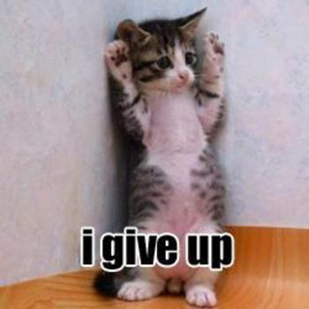
BOSS BATTLE BRANCH!
Now you have a choice:
Fight
Retreat
Give up

Slide 27
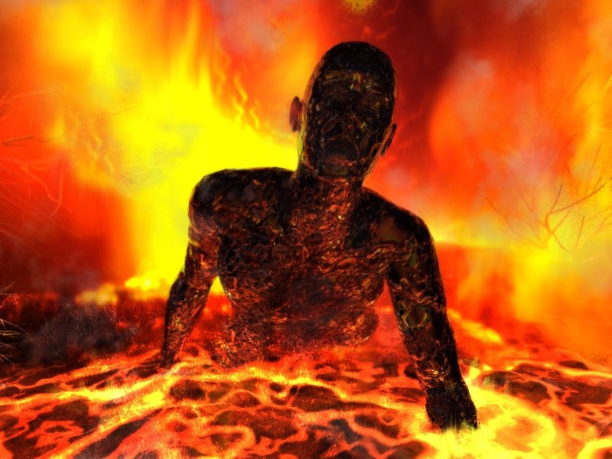
Retreat
You run, but you get burned and eaten by the devil. RIP. Go to HELL!
One Step Back
Back to Start

Slide 28
Give up
You give up life, and get burned and eaten by the monster. Giving up was never a good idea. GO TO HELL!
One Step Back
Back to Start

Slide 29
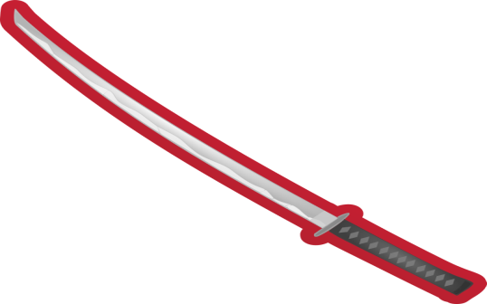
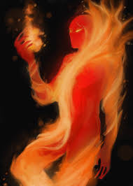
Fight
You choose to fight, you have two choices:
Get out your sword and use your immunity to fire
Punch the devil

Slide 30
Punch the devil
You get burned by the devil, and you’re cursed, so now you have no choice, but to spend the rest of your life in hell.
One step back
Back to start

Slide 31
Get out your sword and immunity to fire
You get burned by the devil, but you’re immune to fire. You come in with a awesome slash, and then bang! You kill the devil, and the devil falls! YOU WIN all three TRIALS!
Continue
Back one Step
Back to Start

Slide 32
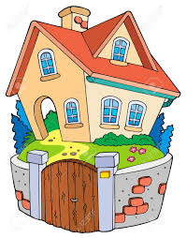
Continue
Gru has no choice, but give you the minions, but you have one last choice:
Go home
Explore

Slide 33
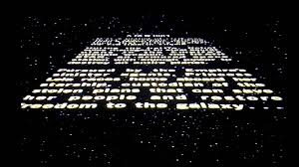
Go home
You win, and you saved the minions! You have all the minions at your house, and you lived happily ever after!
Credits

Slide 34
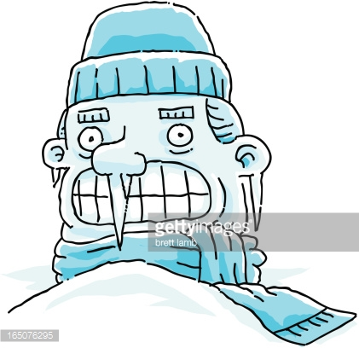
Explore
Since Gru wants you to go home, he kills you by freezing you with the freeze ray, then chopping your head off. RIP. Gru is the devil.
One step back
Back to Start

Slide 35
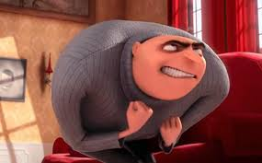
Credits
A last message from the author:
Thanks for playing. Thank you for all your support.
Over 2 hours of work.
Watch Ssundee and Popularmmos on Youtube.
Thanks, once again.
But Gru says I WILL RETURN! Gru is the DEVIL!
Back to Start

