Slide 1
Python Lesson’S 1 & 2
Mr. Kalmes

Slide 2
Do Now
List all of the mathematical symbols that you know that have applied to coding in the past.
We will go over these as a class.

Slide 3
Open the idle module and then a new file.
The file should be saved as lastname_calculations
Make sure you make a folder for your work on the desktop.

Slide 4
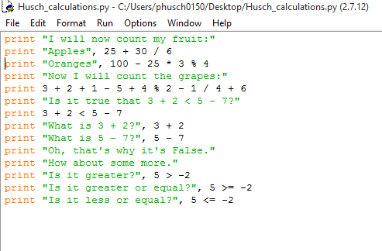
Type the following

Slide 5
Exit Slip Questions
What happens when the print command does not have quotation marks around the equation?
Does this program take any inputs?
Are there any Variables in this program?

Slide 6
Turn in your work
Turn your work into the drop box

