Slide 1
Python Lessons 13 & 14
Mr. Kalmes

Slide 2
Aims
I will be able to create code that allows user inputs in the command prompt
I will be able use the read command to open a file in the cmd prompt

Slide 3
Lesson 13

Slide 4
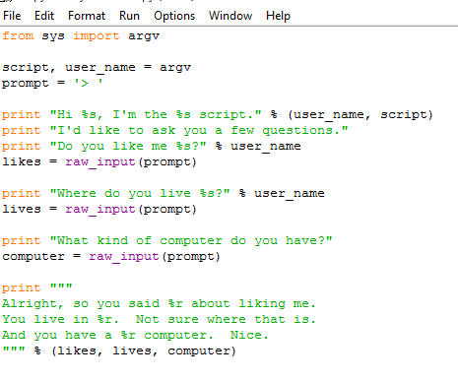
DO Now
Recreate this program & save as lesson13.py

Slide 5
Lesson 13 Activity
You need to test the original program and then add 5 more questions for a total of 8 and print out all the answers in a paragraph in the end. Please turn this in when you are done.

Slide 6
Lesson 14

Slide 7
Special Notice
PLEASE BE CAUTIOUS, WORKING WITH FILES CAN BE AN EASY WAY TO ERASE YOUR WORK COMPLETELY
*********************

Slide 8
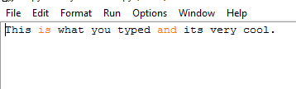
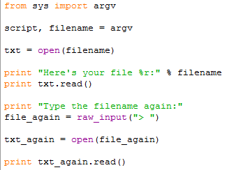
Create the following Programs
Save this at lesson141
Save this at lesson142

Slide 9
Things to look at
Line 1-3 should be a familiar use of argv to get a filename. Next we have line 5 where we use a new command open. Right now, run pydoc open and read the instructions. Notice how like your own scripts and raw_input, it takes a parameter and returns a value you can set to your own variable. You just opened a file.
Line 7 we print a little line, but on line 8 we have something very new and exciting. We call a function on txt. What you got back from open is a file, and it's also got commands you can give it. You give a file a command by using the . (dot or period), the name of the command, and parameters. Just like with open and raw_input. The difference is that when you say txt.read() you are saying, "Hey txt! Do your read command with no parameters!"

Slide 10
Run Your Program
To run this in CMD you need to go to your folder directory that you saved the game in.
You need to type in lesson142.py lesson141.py
This will open both files, with 141 opening up inside 142.

Slide 11
This is what you should see
Here's your file 'lesson14_sample.txt':
This is stuff I typed and it’s very cool.
Type the filename again:
> ex15_sample.txt
This is stuff I typed and it’s very cool.

Slide 12
Making comments
Before turning in your work you need to make comments to lesson 142. To make a comment use the # symbol. Write what each line of code does.

Slide 13
Exit Slip
What word do you need to type in user inputs
What type of file do you need to be able to read it in python

