Slide 1
Python 16
Mr. Husch

Slide 2
Aim
Students will gain a list of commands that should be used other than open for reading and writing files.

Slide 3
What commands do you already know? Here are new commands.
close -- Closes the file. Like File->Save.. in your editor.
read -- Reads the contents of the file, you can assign the result to a variable.
readline -- Reads just one line of a text file.
truncate -- Empties the file, watch out if you care about the file.
write(stuff) -- Writes stuff to the file.

Slide 4
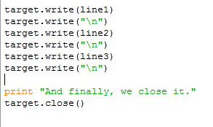
Save as lastname16

Slide 5
Test run
To run the program you need to open it in the CMD.
After you find the file to run it you will need to type in
Python filename.py yourname

Slide 6
Additions to make before turning in.
1) Place one comment line on each line of code to better understand what is occurring
2) Streamline the file by using strings, formats, and escapes in line1, line2, and line3 with just one target.write commands

