Slide 1
Python 17
Mr. Husch

Slide 2
Aim
Students will use function in Python.

Slide 3
Function
1) Functions name pieces of code the way variables name strings and numbers.
2) They takes arguments the way your scripts take argv.
3) They let you make your own mini scripts and mini commands.
Functions can be created by using the word def.

Slide 4
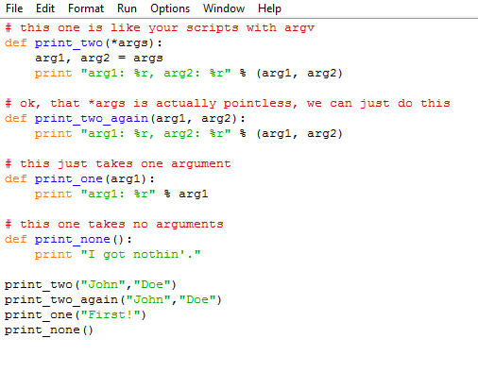
Create this program. lastname17

Slide 5
Explaining lines
First we tell Python we want to make a function using def for "define".
On the same line as def we then give the function a name, in this case we just called it "print_two" but it could be "peanuts" too. It doesn't matter, except that your function should have a short name that says what it does.
Then we tell it we want *args (asterisk args) which is a lot like your argv parameter but for functions. This has to go inside () parenthesis to work.
Then we end this line with a : colon, and start indenting.
After the colon all the lines that are indented 4 spaces will become attached to this name, print_two. Our first indented line is one that unpacks the arguments the same as with your scripts.

Slide 6
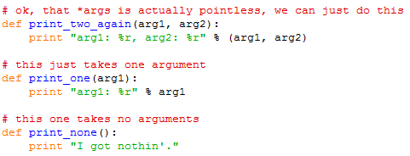
Explaining the rest
Now, the problem with print_two is that it's not the easiest way to make a function. In Python we can skip the whole unpacking args and just use the names we want right inside (). That's what print_two_again does. After that you have an example of how you make a function that takes one argument in print_one. Finally you have a function that has no arguments in print_none.

Slide 7
Running the program
You should see what I have posted above, make sure when you run it you put in a random word after your 17 program so that it runs.

Slide 8
Building a Function Checklist
1) Did you start your function definition with def?
2) Does your function name have only characters and _ (underscore) characters?
3) Did you put an open parenthesis ( right after the function name?
4) Did you put your arguments after the parenthesis ( separated by commas?
5) Did you make each argument unique (meaning no duplicated names).
6) Did you put a close parenthesis and a colon ): after the arguments?
7) Did you indent all lines of code you want in the function 4 spaces? No more, no less.
8) Did you "end" your function by going back to writing with no indent?

Slide 9
Running a function checklist
1. Did you call/use/run this function by typing its name?
2. Did you put ( character after the name to run it?
3. Did you put the values you want into the parenthesis separated by commas?
4. Did you end the function call with a ) character

Slide 10
Use the checklists to create your program that you will be turning in.
The program should have 4 functions in it, you can use what you started with as a working off point. All functions must work and print the arguments out at the end.

