Slide 1
Python 18
Mr. Husch

Slide 2
Aim
Continue working on functions

Slide 3
Today’s outline
You will be working on 3 programs I provide today and one of your own making.
Both programs work on functions.

Slide 4
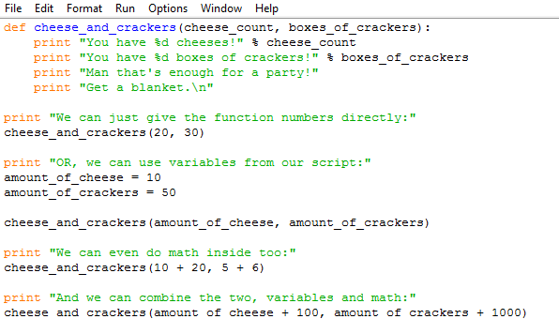
Code #1 save as 181, to turn in you need to comment on what the lines do. This can run in the shell.

Slide 5
Save as 182test.py
To all the people out there.
I say I don't like my hair.
I need to shave it off.
You need to make a very simple file that only has these 3 lines.

Slide 6
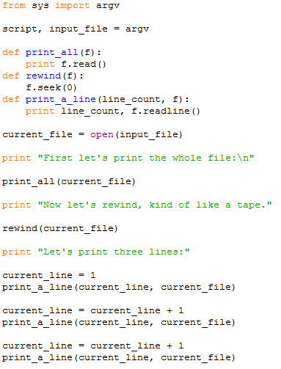
Save as 182.py
You need to make comments to turn it in.
To run this file, you need to use the CMD.
When you run it you will need to type:
Python 182.py 182test.py

Slide 7
The program that you need to build 183.py
Build a new program that you can run inside of 182 just like the 182 test. This program needs to be more complex than just 3 lines that do nothing, but I am giving you some freedom to pick what it will do.
At the end of the lesson you need to turn in all of these assignments to me.

