Slide 1
Python 19
Mr. Husch

Slide 2
Aim
Students will begin using return and = to assign variables to be the value of the function.

Slide 3
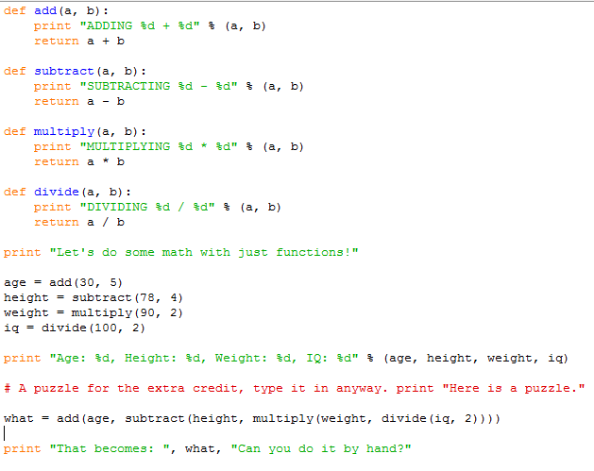
Save as 19 This Can be run in the shell

Slide 4
Comments
You need to comment on each section of the code.
In your comments you need to tell me where the function using the return command is.
In your comments you need to tell me how is the formula using function at the end of the script.

Slide 5
19.5
Change the program so that it has the USER input their information.
Add 3 pieces of information for the program to gather.
Add the three additional pieces of information to the math problem at the end of the program, you can make the math problem anything that you want.
Make comments telling about the changes that you made to the program.

Slide 6
Turn in
Turn in both 19 and 19.5

