Slide 1
Python Lesson 21
Mr. Kalmes

Slide 2
Aims
I will be able to explain a conditional statement
I will be able to create programs with conditional statements

Slide 3
IF-STATEMENTS
A statement where an action will occur if certain conditions are met. For example, if my stomach growls, get me food! Or, if I am a body cast, I probably angered a pro wrestler.

Slide 4
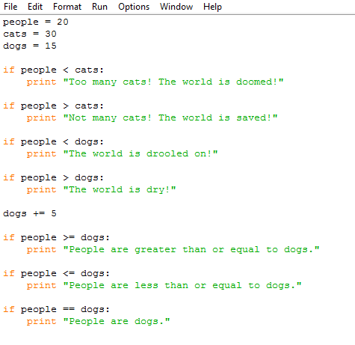
Example Program

Slide 5
Challenge Activity
Create a program with the following criteria:
Includes 8 if statements
Allows user input for all variable
Print statements based on user input

Slide 6
EXIT SLIP
What is an if-then statement?
Give an example of an if-then statement

