Slide 1
Python Lesson 22
Mr. Kalmes

Slide 2
Aims
I will be able to explain a else statements
I will be able to create programs with else statements

Slide 3
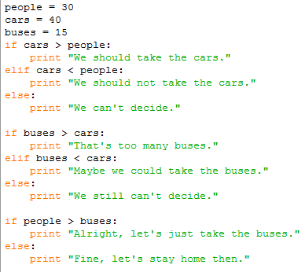
ELIF Example

Slide 4
Challenge Activity
Create a program with the following criteria:
Includes 8 statements with if, elif, and else
Allows user input for all variable
Print statements based on user input

Slide 5
EXIT SLIP
What is the purpose of an elif statement

