Slide 1
Python Lessons 23
Mr. Kalmes

Slide 2
Aims
Explain and use the go to function
Create a Mad Lib Game

Slide 3
Do Now
Explain what a Mad Lib is

Slide 4
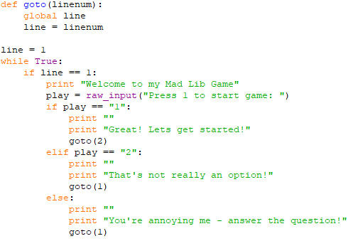
Lesson 23 Example

Slide 5
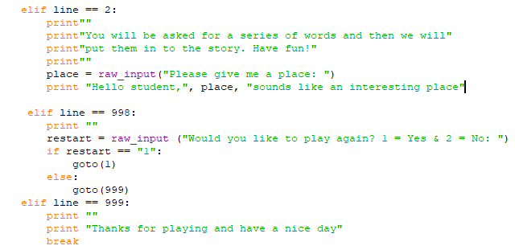
Lesson 23 Example

Slide 6
Lesson 23 Activity
Requirements:
Create a Mad Lib with at least 15 inputs
Must have a title screen
Must be repeatable
Must use go to function
Must use raw_inputs

Slide 7
Exit Slip Questions
What is the topic of your Mad Lib

