Slide 1
Python Lesson 3
Mr. Kalmes

Slide 2
Lesson Overview
This lesson introduces how to program variables into Python.
Objectives:
Students will Define what variables are used for.
Create a sequence of code utilizing variables.

Slide 3
Vocab
What are variables and what they are used for in coding?
Variables are representations of something more complex like the variable age might represent the calculation “current year – birth year”. If we would type in print age the terminal would display the age of the user.

Slide 4
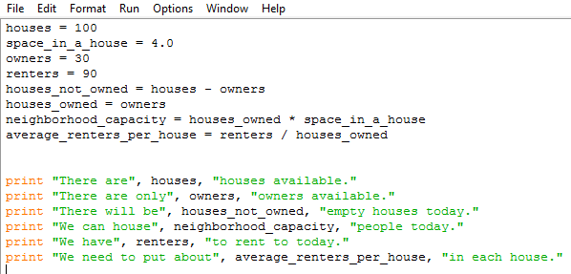
Activity 1

Slide 5
Activity 1

Slide 6
Activity 2
Try and write a code, based off the same ideas in the code you did earlier. This code should be based on a grocery store. You will need to include things like isles, items in the store, check out clerks, and customers. You can decide what the final information is that is printed out, but use those basic ideas to write some variables that work together to tell me about your fictional store.

Slide 7
Exit Slip
Please complete your exit slip via google forms
Exit Slip Question:
In what other ways could you use variables in python?

