Slide 1
Python Lesson 4
Mr. Kalmes

Slide 2
Objective
Create code using strings
Deduce how to code strings

Slide 3
Do Now
Look up the definition of strings as it relates to coding
What is the difference between variables and strings?

Slide 4
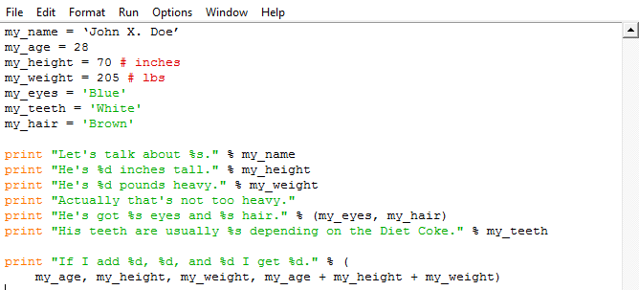
Activity 1
Type the following

Slide 5
Activity 2
Part 1:
- Recreate activity 1 but use different variables and a different story
Part 2:
- Write a program that convert pounds to kilos to inches to centimeters using new variables

Slide 6
Exit Slip
What are the variables in the code?
What are the strings?

