Slide 1
PYTHON LESSON 5
Mr. Kalmes

Slide 2
Objective
Create a syntax error log

Slide 3
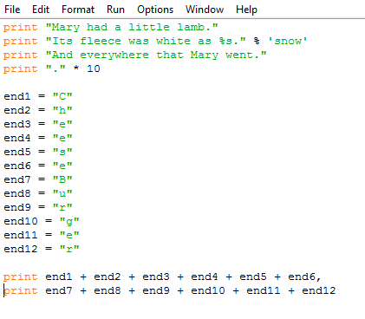
Create this program, call it python5

Slide 4
Additions to the code
Place a comment line explaining what each section of code does.
What does the “.” * 10 do?
What does the comma after end6 do?
What happens when you remove the comma after end6?
Log any mistakes you made, review them, and do not repeat them in your next code.

Slide 5
Fill out the journal that is asking the questions from this PowerPoint
If you have completed all of this then you are free to relax quietly or get work for another class done.

