Slide 1
Python Lesson 6
Mr. Kalmes

Slide 2
Objective
Understand the difference between %r, %s, & %d
Understand how to use inputs in python

Slide 3
%R, %S, %D What’s the difference
%R = Raw Data. It will print in the format it is written in
%S = String Data. Mainly used for alpha characters
%D = Integer Data. Mainly used for numeric characters

Slide 4
Enter the following code: Save as Lastname_python6

Slide 5
We now have a little baseline, for the rest of class work on the following website.
https://www.codecademy.com/learn/python

Slide 6
How to use input in Python.
INPUT is a function in Python 2, the one that we are using, but it does not work the way you would expect it to. It is looking for you to run code inside the input, something that you will not really be doing right now.
Raw_input will allow users to input something into the program and have the program use the information like a string, which is what you will want most of the time.

Slide 7
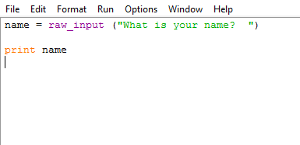
Practice using inputs
Create a program for me that has 15 raw_inputs and displays them.
Combine a few of the inputs into a single print

Slide 8
Exit Slip
1) What changes from the code to the display in the one, two, three, four sequence?
2) What are parentheses used for in this code?
3) What changes to the code if you switch %r to %s?
Log any errors and do not repeat them next time

