Slide 1
Python Lessons 7 & 8
Mr. Kalmes

Slide 2
Aims
Explore new characters used in Python
Explore new symbols used in Python
Understand escape sequences

Slide 3
Python Lesson 7

Slide 4
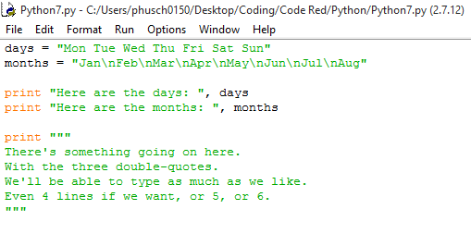
Lesson 7 Activity A

Slide 5
Lesson 7 activity B
- Build a program that uses \n and “””
  It should list your class schedule and teachers. A-days should be done horizontally and B-days should be done vertically
  You should also use the “”” to create a short paragraph describing your favorite class and why

Slide 6
Python Lesson 8

Slide 7
Escape Sequences
Escape Sequences: allow you to put difficult to type things into a string.
Some examples of escape sequences are:
  \t (this will tab in a line),
  \\ (this will show one \ in the actual code)
  \” allows you to put a double quote in the text
  \’ allows you to put a single quote in the text

Slide 8
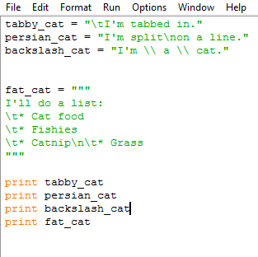
Lesson 8 Activity
Copy the following code and turn it in to the drop box when you are finished

Slide 9
Exit Slip Questions
What does the \n do?
What do the triple “ do to the code?
What does \t and \\ do?

