Slide 1
Python Final
Mr. Kalmes

Slide 2
Aims
Explain a CYA Game
Map my CYA Game
Explain the requirements

Slide 3
Do Now
Explain what a CYA Game is

Slide 4
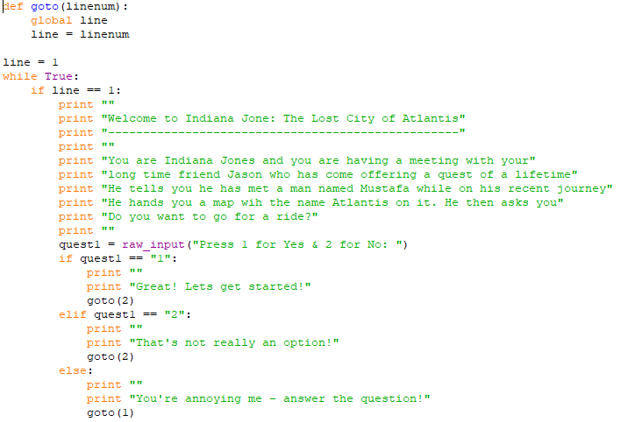
CYA Game Example Part 1

Slide 5
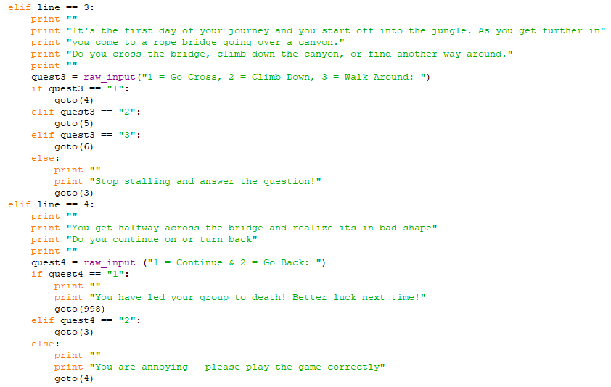
CYA Game Example Part 2

Slide 6
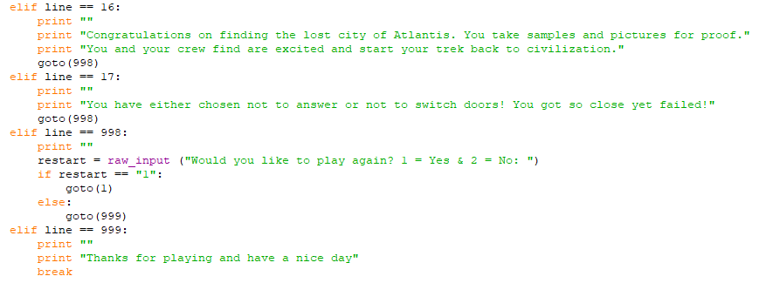
CYA Game Example Part 3

Slide 7
CYA Game requirements
Requirements:
Must have at least 30 rooms
Must be repeatable
Must be winnable
Must be school appropriate
Rubric:
See website

