Slide 1
The Machine.
next

Slide 2
Awakening
One day a boy woke up from a deep sleep. He saw his hands…
One was flesh and the other was METAL.
He saw he was tied up in a hospital looking room. His metal arm broke the chains. A siren went off. You walk in the hall and there are 2 guards.
Fight Run around the corner

Slide 3
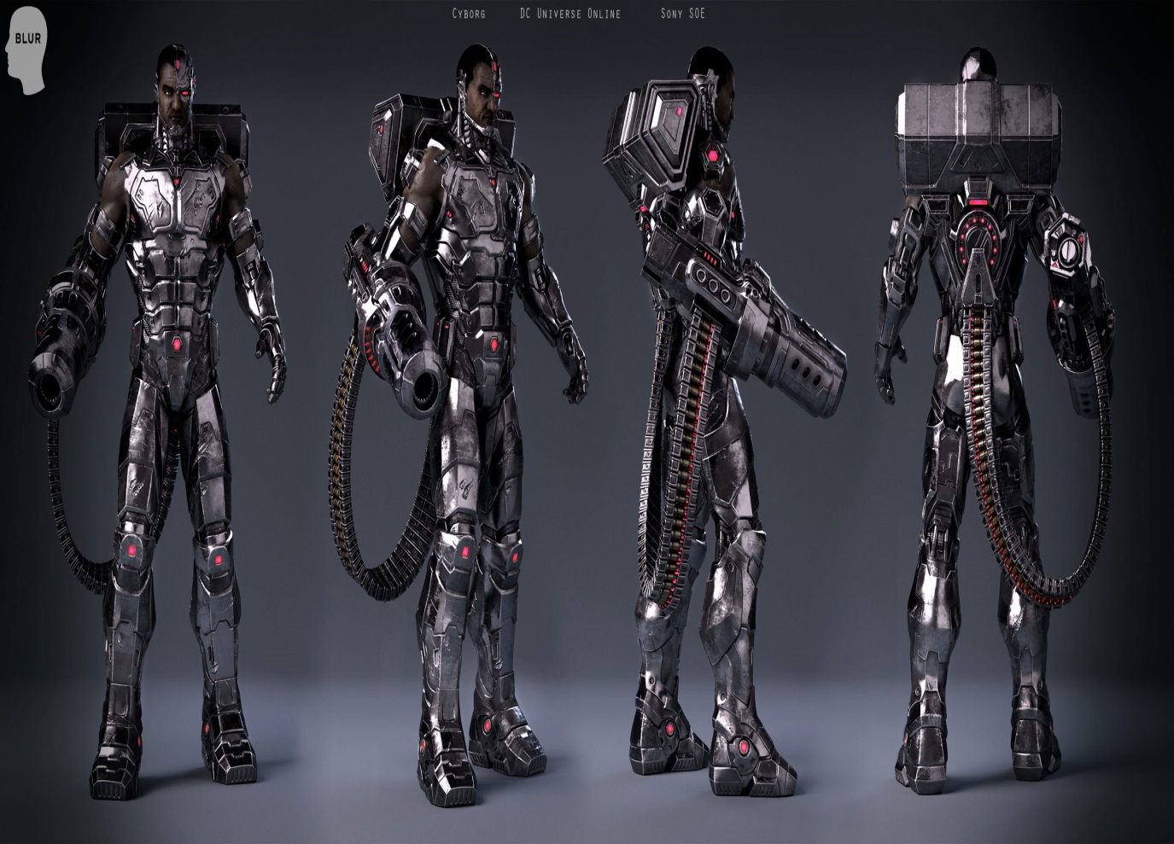
Fight
Your cyborg arm punches one guy down the hall way… the other runs. You survive.
Time to escape

Slide 4
Run
12 more guys are down the hall and you get shot. You die.
Restart

Slide 5
The Escape
You get out of the building and you see a jet and a jeep.
Jeep Jet

Slide 6
Jet
You the fly away but you see an RPG coming your way but you dodge it and escape.
Next

Slide 7
Jeep
You drive away but you get hit my an RPG. You die.
Restart

Slide 8
Landing
You land but something isn’t right. There are 3 robot soldiers that are surrounding you!!
Fight them head on Punch a boulder on the cliff
Activate 1 of the 3 special effects of your arm

Slide 9
Fight
You punch one and his face gets torn to pieces. You try to punch the other but he catches your fist and the other joins in to destroy you. You die.
Restart

Slide 10
Special
You shoot a huge laser and cut through the robots and the mountain. You fly away in your jet back to the military base to find out what happened to yourself.
Next

Slide 11
Strategy Fails
You punch the boulder and it falls and crushes the robots and you. You die.
Restart

Slide 12
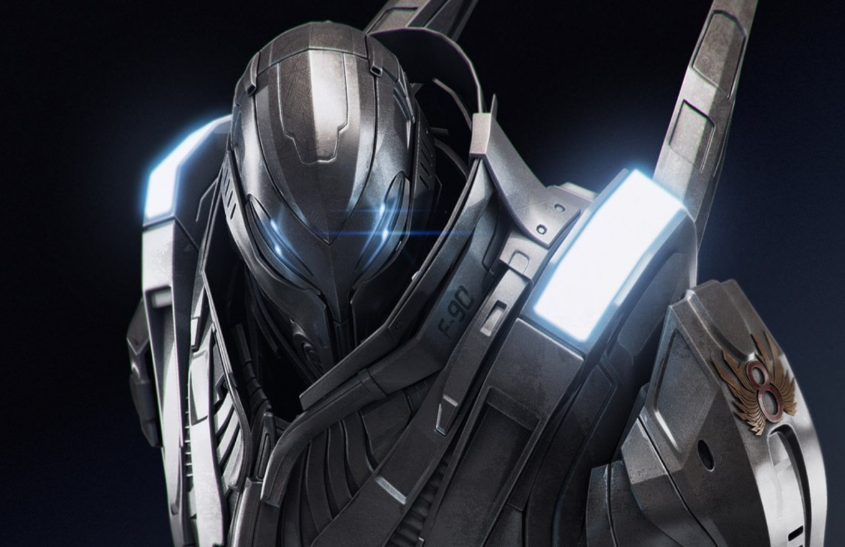
The Army
There is an Army of 1000!!!!
Shoot your Laser
Fight head on

Slide 13
Army 2
You take out 200 Robots
Use your missiles
Fight head on

Slide 14
Fight
There are too many. You die.
Restart

Slide 15
Army 3
You take out 300 robots.
Use you black hole creator
Fight head on

Slide 16
Army 4
You destroy all of the robots and you see 3 doors. Which one?
Door 1 Door 2 Door 3

Slide 17
Door 1
There is a bomb and it blows. You die.
Restart

Slide 18
Door 2
You walk through the door and you see a scientist. He says he saved you from a horrible accident. You then ask for your memory. He gives you a chip and you start to remember.
Next

Slide 19
Door 3
A bucket of gasoline falls on your head. Some one throws a lighter on you and you burn to death. You die.
Restart

Slide 20
The End
You kill him for turning you into a cyborg.
The End

